Slide 1
Depression

Slide 2
Depression

Slide 3
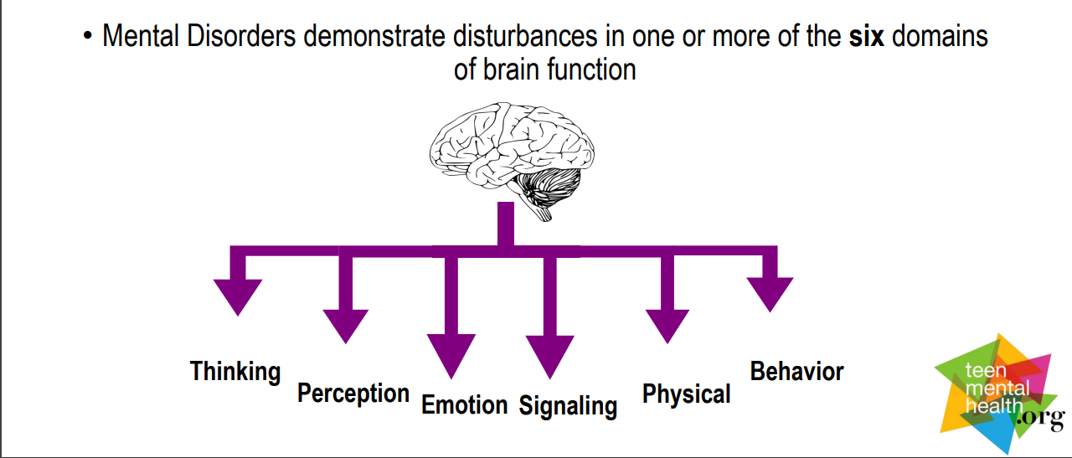
Depression – is a disturbance in emotion ______________________

Slide 6
Depression is a mood disorder that:
Is characterized by persistent and sustained:
- depressed mood
- loss of interest
- guilty ruminations
- feelings of hopelessness/worthlessness
- fatigue
- concentration problems
- loss of appetite
- loss of pleasure
- suicidal thoughts/actions

Slide 7
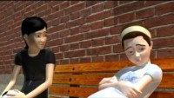

Slide 8
Treatment
A healthy lifestyle can help decrease the symptoms of depression
- exercise
- sleep
- nutrition
Combination of psychotherapy (usually Cognitive Behavioural Therapy) and an antidepressant medication (usually SSRI – Selective Serotonin Reuptake Inhibitor)

