Slide 1
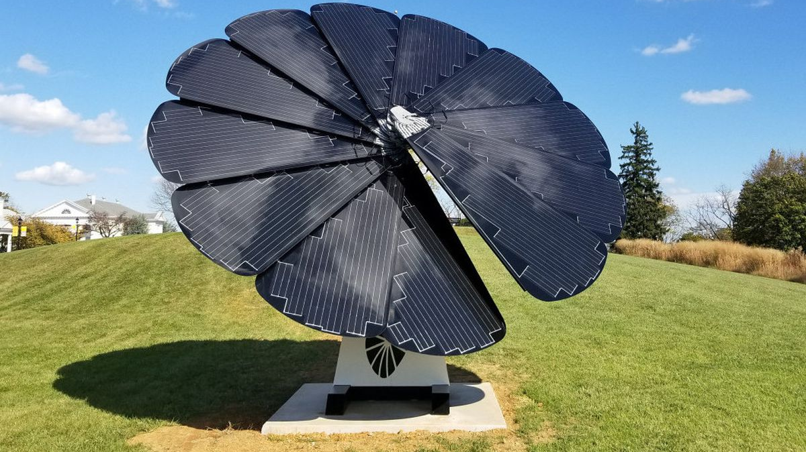
Solar Technology and the SmartFlower @ BJM High School
Developed for Science 10

Slide 2
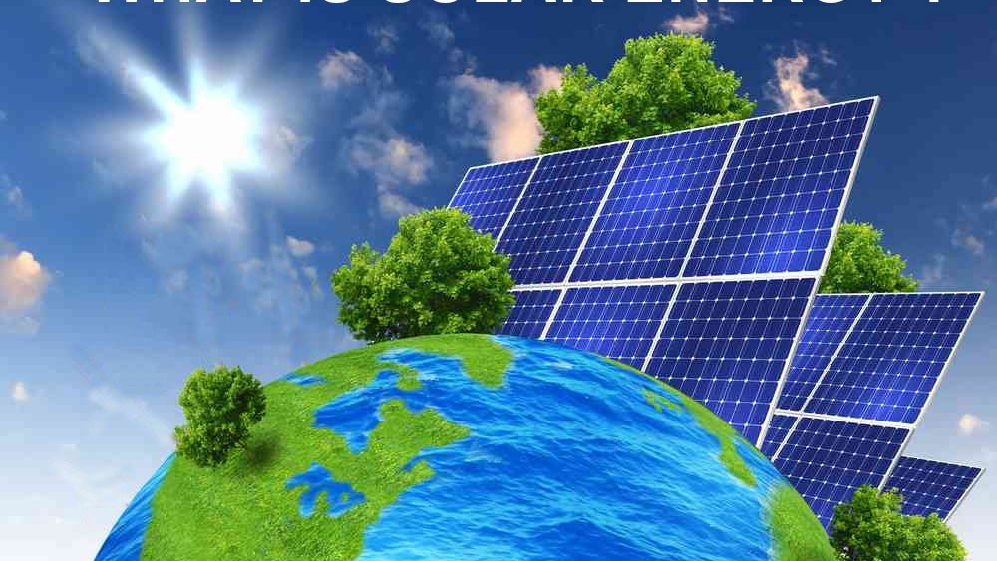
What is Solar Power?
Solar power involves the capture and conversion of energy within sunlight to electricity
The amount of sunlight that hits the Earth’s surface in 90 minutes is enough to cover all the energy demands of humanity for an entire year.

Slide 3
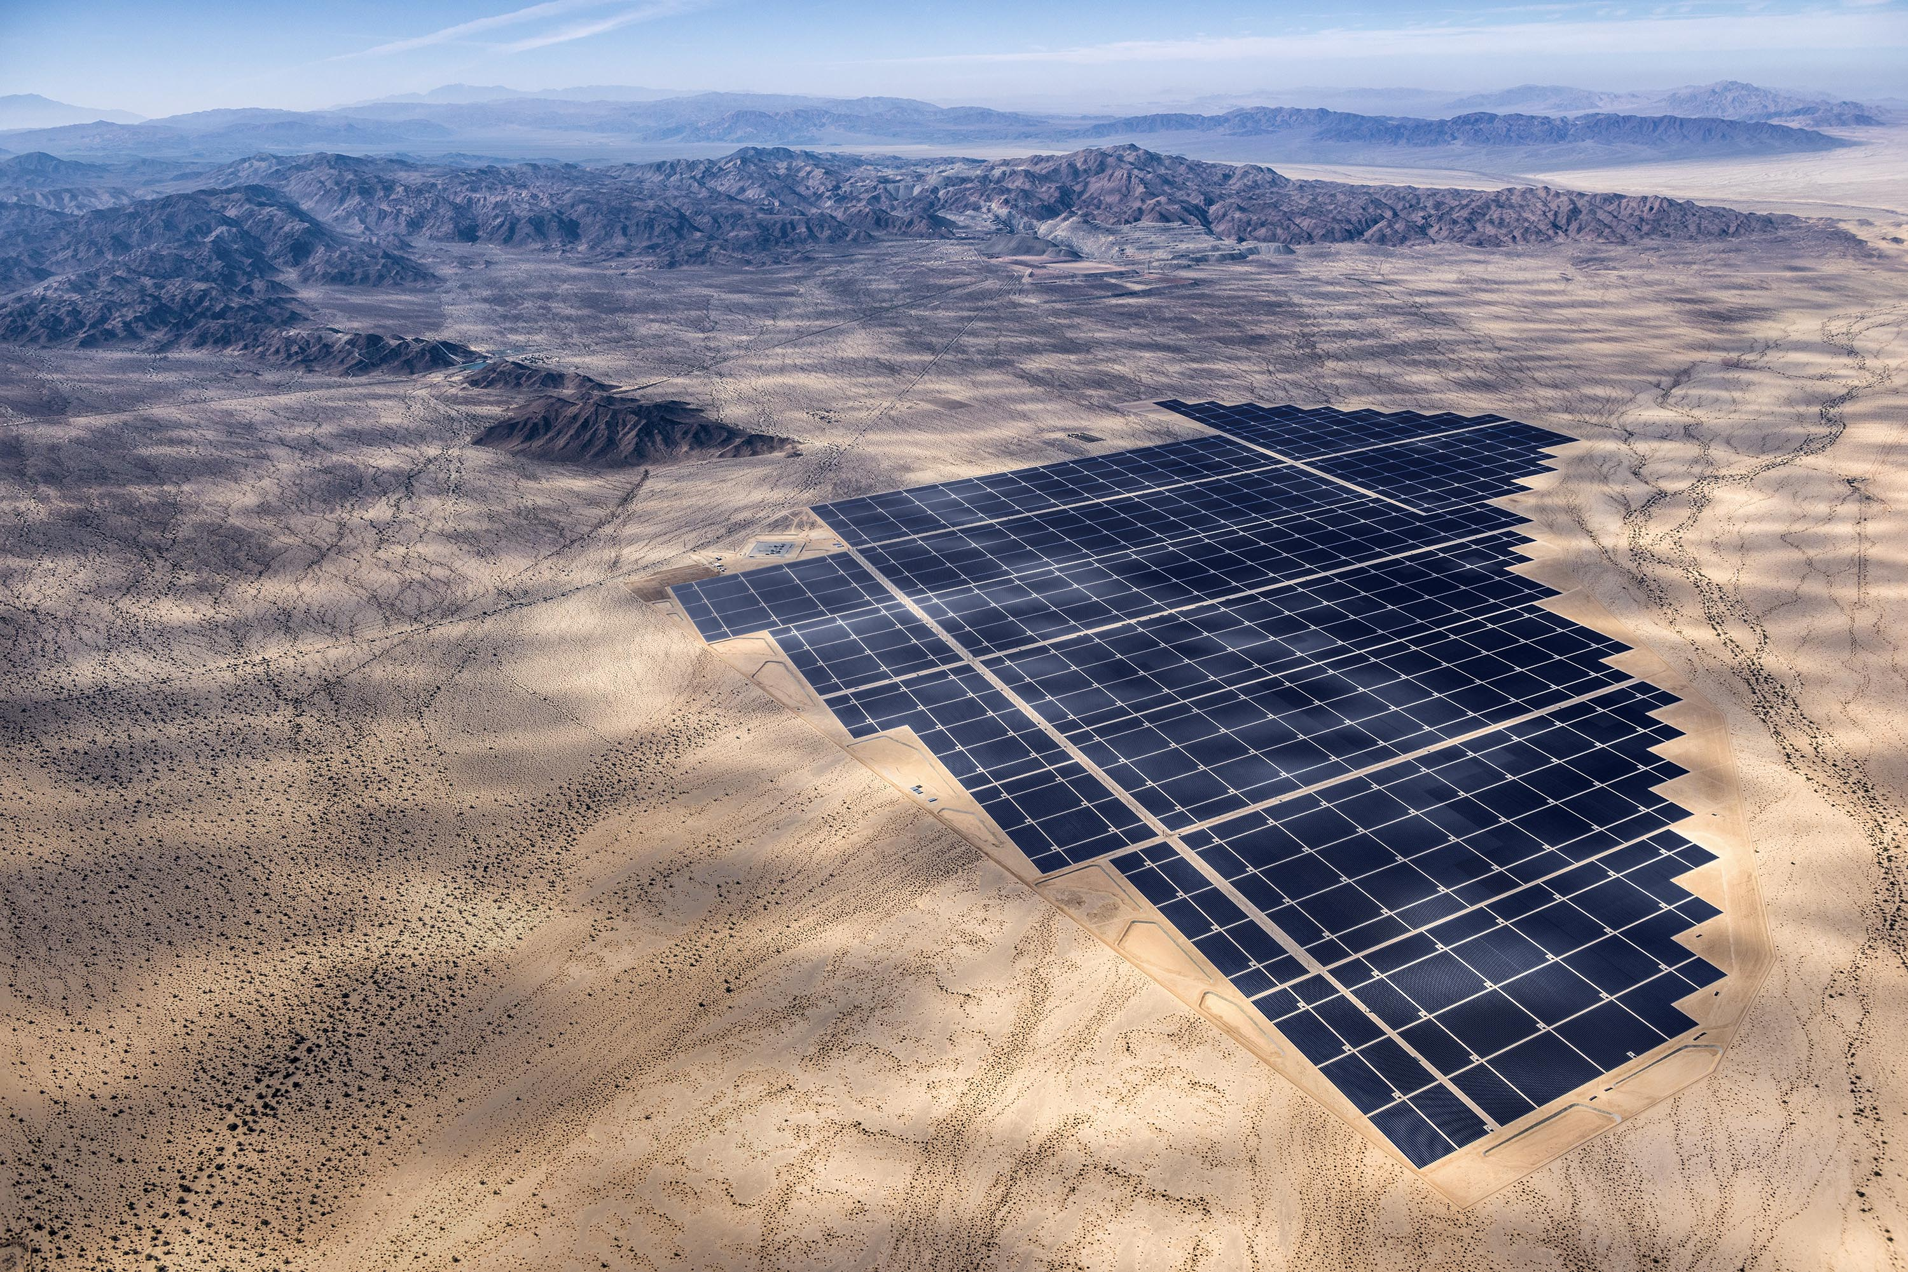
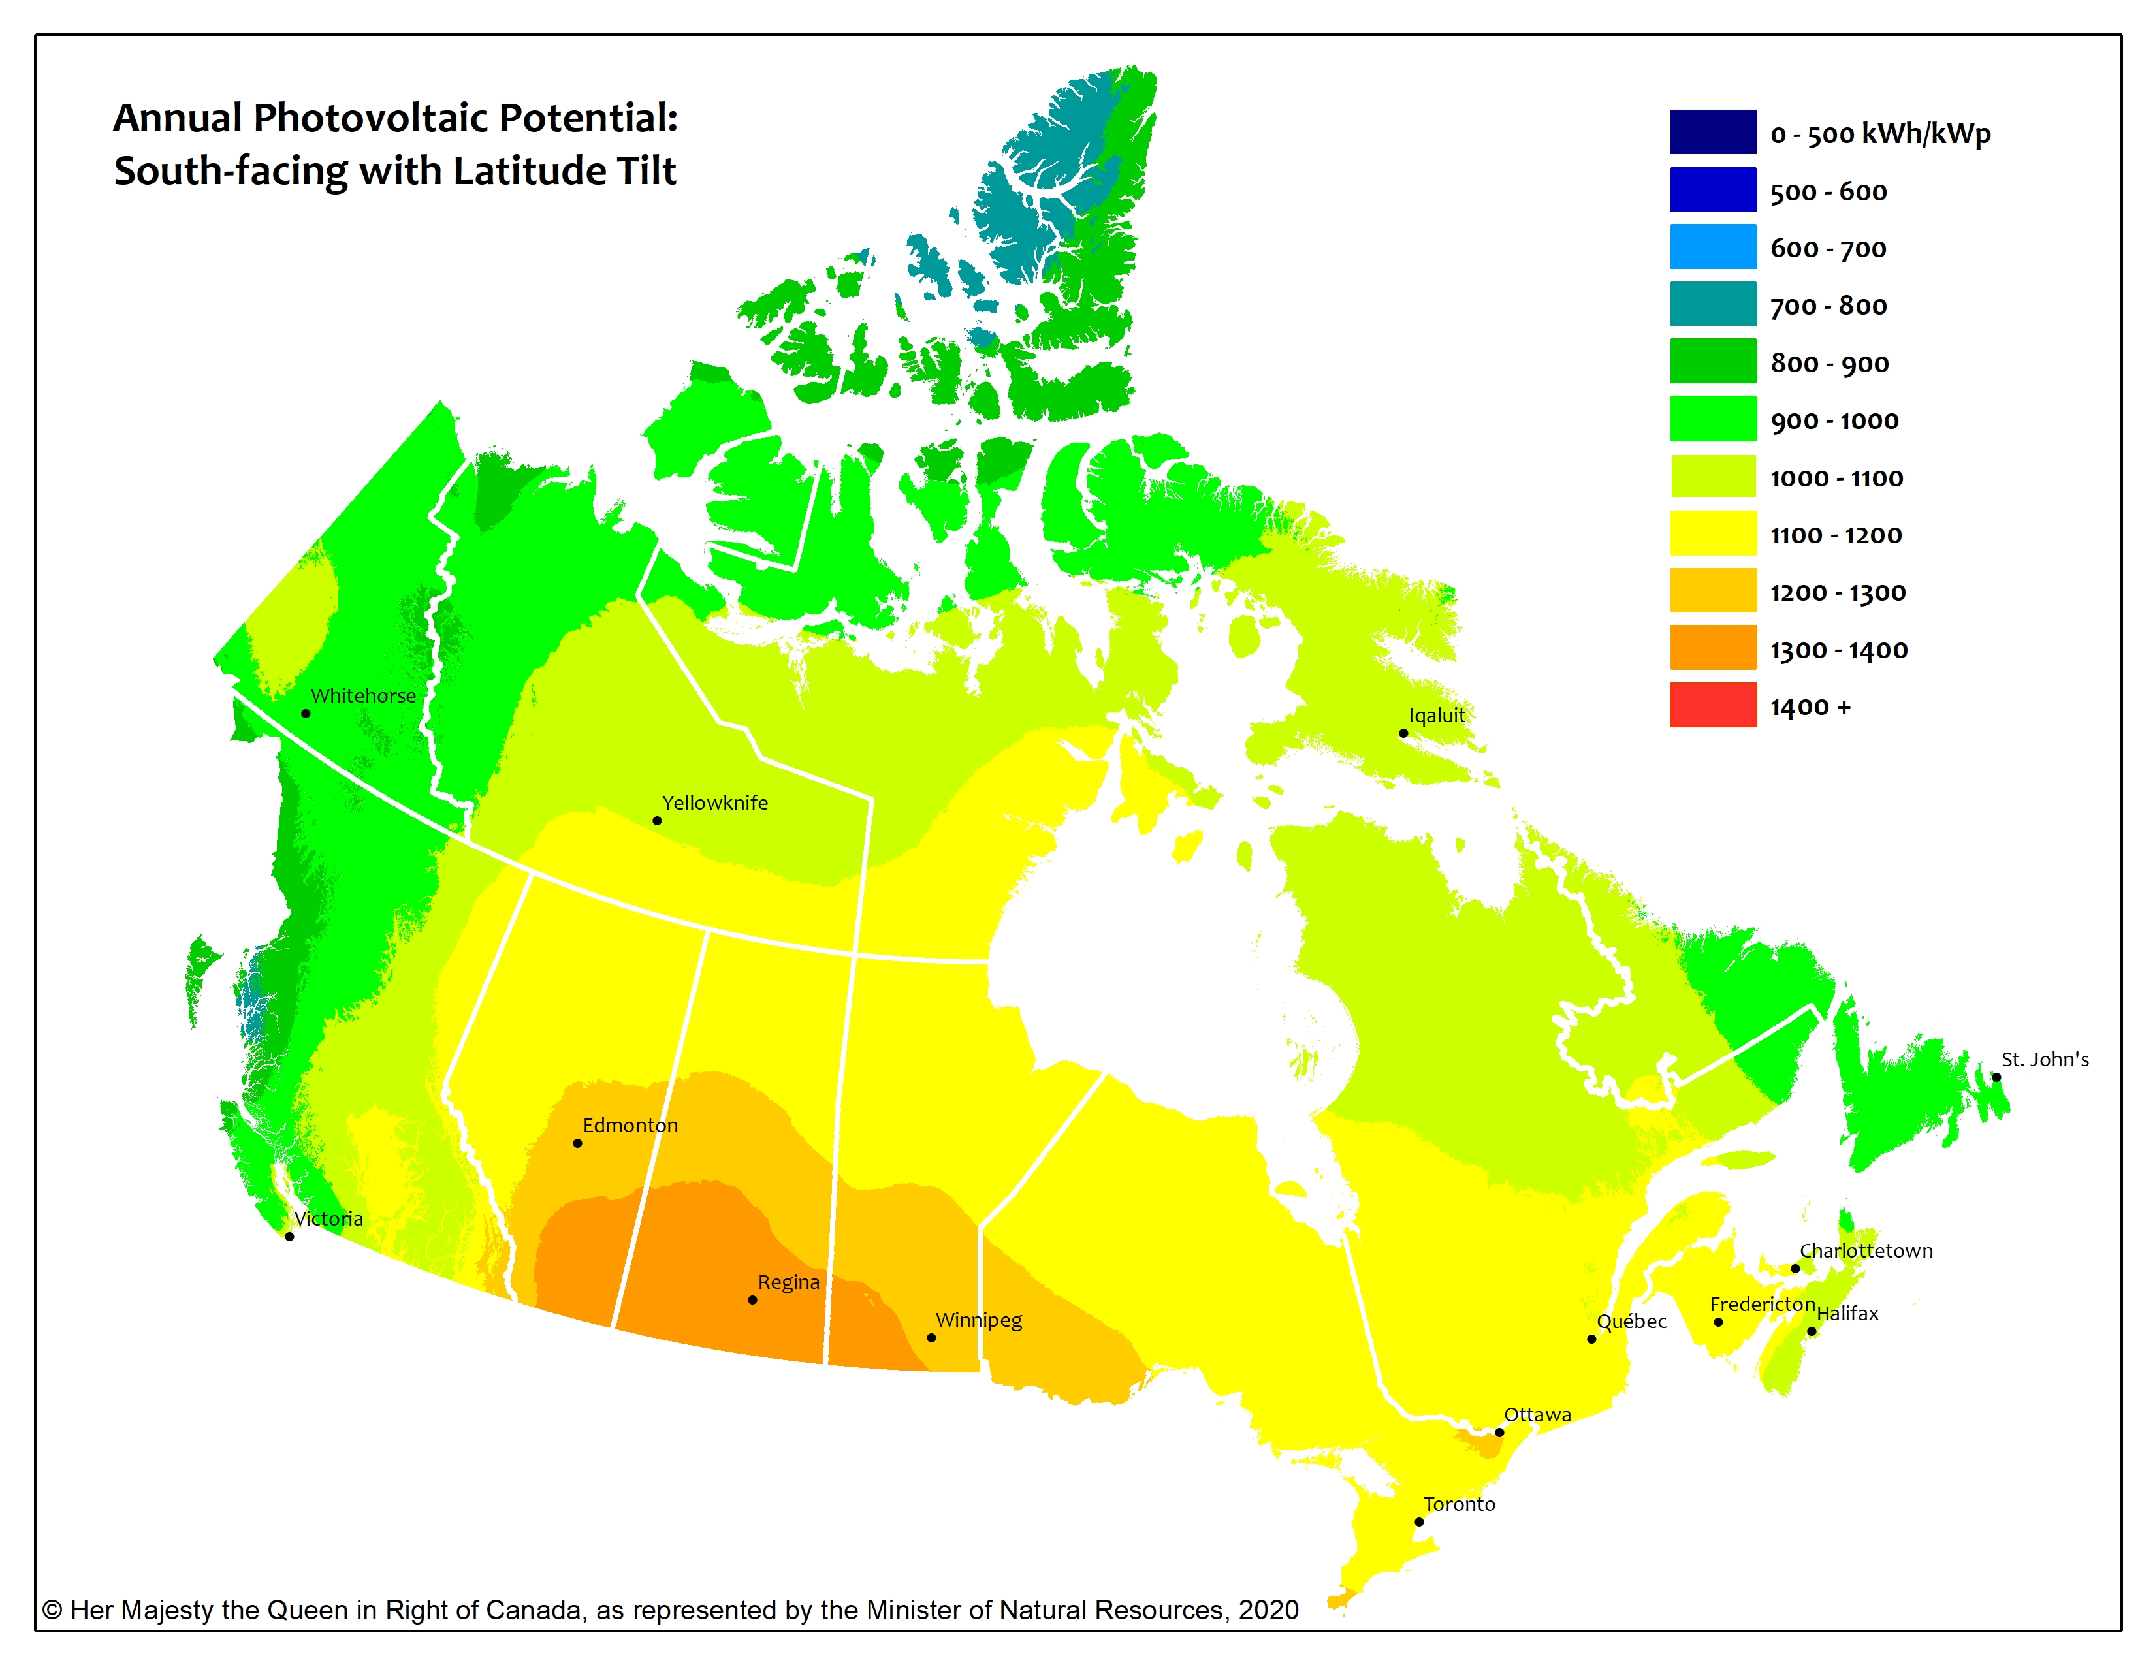
To create solar power you need sunlight…
Southern Saskatchewan gets more hours of cloud free sunlight than anywhere in Canada
Saskatoon Shines
Sunny Saskatchewan
Humanity is choosing to set up utility solar power plants in locations that have much more continuous solar exposure.
Large solar installations tend to be in deserts or grasslands, not on arable land
Also not common to have large installations in locations that receive continuous rain and cloud cover (ex. Prince Rupert, BC; St. John’s, Newfoundland)

Slide 4
Do we get the same amount of sunlight all year round?
No!
In Saskatoon (much further away from the equator) there can be 16 or more hours of sunlight in the summer and 8 or less hours of sunlight in the winter
Solar output is inconsistent
Close to the equator there is close to 12 hours of sunlight and 12 hours of darkness all year long
Solar output would be quite consistent

Slide 5
Hours of Sunlight Available to Produce Solar Energy in Saskatoon
Date | Sunrise | Sunset | Hours of Sunlight | Hours of Darkness
January 21, 2022 | 9:01 | 5:34 | 8:33 | 15:27
February 21, 2022 | 8:09 | 6:31 | 10:23 | 13:37
March 21, 2022** | 7:06 | 7:21 | 12:15 | 11:45
April 21, 2022 | 5:56 | 8:15 | 14:19 | 9:41
May 21, 2022 | 5:03 | 9:03 | 16:00 | 8:00
June 21, 2022* | 4:45 | 9:31 | 16:45 | 7:15
July 21, 2022 | 5:12 | 9:13 | 16:01 | 7:59
August 21, 2022 | 6:00 | 8:17 | 14:17 | 9:43
Sept. 21, 2022** | 6:51 | 7:06 | 12:16 | 11:44
October 21, 2022 | 7:42 | 5:59 | 10:17 | 13:43
November 21, 2022 | 8:37 | 5:07 | 8:29 | 15:31
December 21, 2022* | 9:12 | 4:55 | 7:43 | 16:17
https://www.timeanddate.com/sun/canada/saskatoon?month=6&year=2022

Slide 6
Solar Output by Month Data from Athens, Greece would look different for Saskatoon (different latitude)
WHY DOES THIS HAPPEN

Slide 7
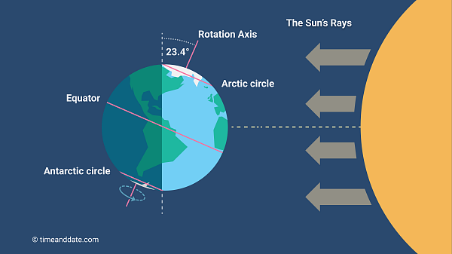
Tilt of the Earth
Every 24 hours it spins on its rotation axis
Every 365.26 days the Earth revolves around the sun
The Earth does not sit straight up and down on its axis.
It is tilted 23.4 degrees

Slide 8
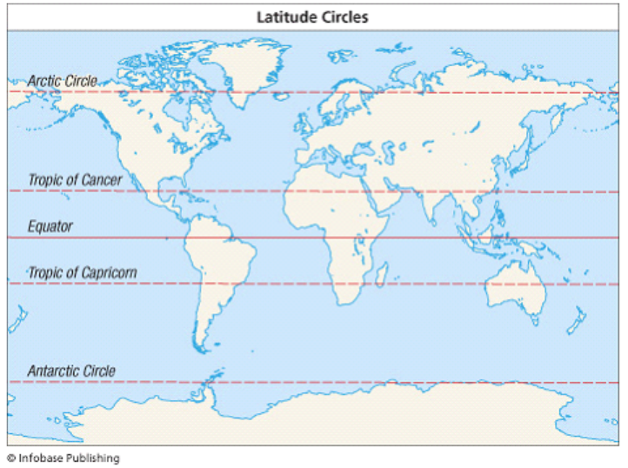
Tilt of the Earth
On any map / globe of the Earth there are five major lines of latitude that are marked:
Equator (zero degrees)
Tropic of Cancer (23.4 degrees North),
Tropic of Capricorn (23.4 degrees South)
Arctic Circle (66.6 degrees North)
Antarctic Circle (66.6 degrees South)
These specific latitudes are marked because of the tilt of the Earth (23.4 degree)

Slide 9
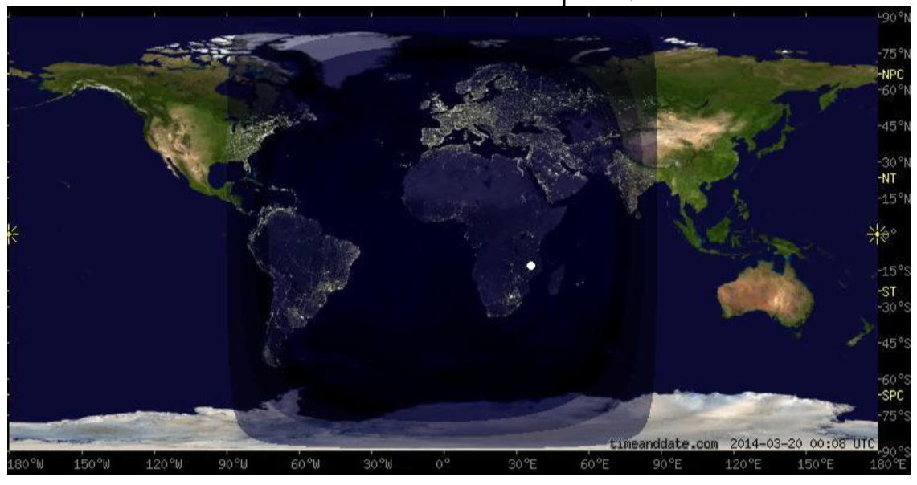
Equinox – September 21st and March 21st
Image on the right illustrates that there is direct sunlight at the equator.
There are 12 hours of sunlight and 12 hours of darkness everywhere on Earth.

Slide 10
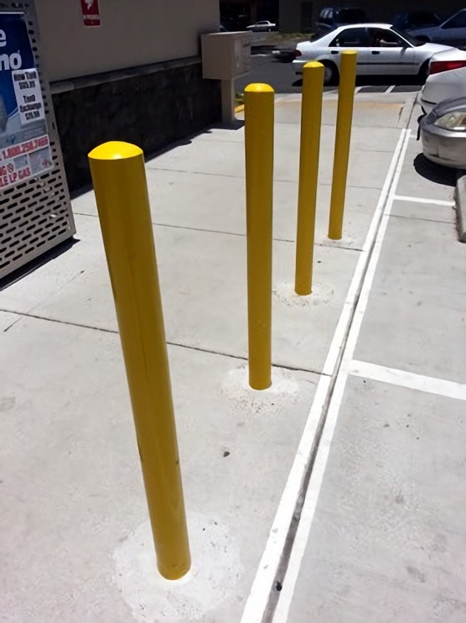
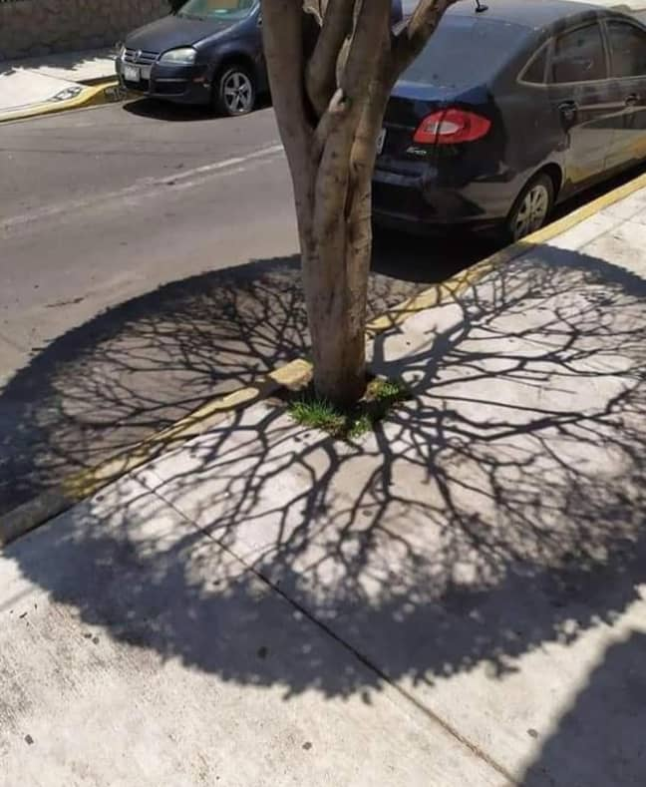
What is direct sunlight?
Sunlight that comes in perpendicular the surface of the Earth. (90 degrees)
Some objects cast no shadow!
This happens everywhere on Earth between the Tropic of Cancer and Tropic of Capricorn
It is impossible outside of the tropics

Slide 11
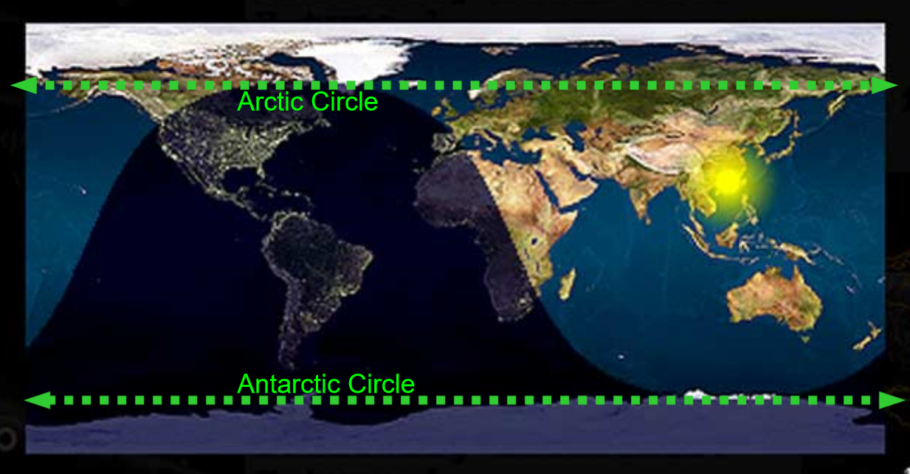
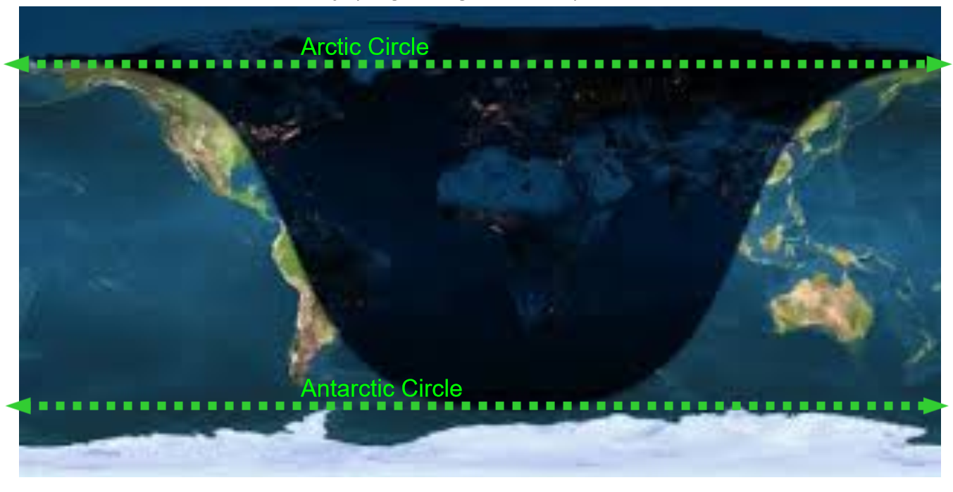
What is perpetual darkness and perpetual sunlight?
Outside of the Arctic and Antarctic Circle it is possible for the sun to never rise or never set.
First Photo – Summer Solstice
Perpetual Sun North of the Arctic Circle
Perpetual Darkness South of the Antarctic Circle
Second Photo – Winter Solstice
Perpetual Darkness North of the Arctic Circle
Perpetual Sun South of the Antarctic Circle

Slide 12
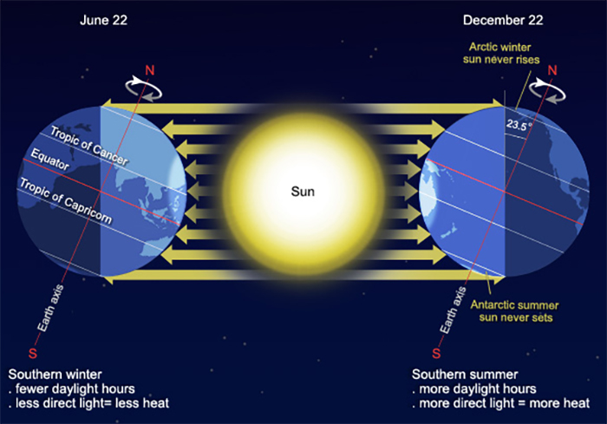
Why Do We Have Seasons? Summer vs. Winter
Arctic Summer
On its path around the sun the Northern Hemisphere is tilted toward the sun during summer.
More hours of sunlight in Northern Hemisphere
Direct solar radiation at Tropic of Cancer on June 21st
Arctic Winter
On its path around the sun the Northern Hemisphere is tilted away from the sun in the winter.
Less hours of sunlight
Direct solar radiation at Tropic of Capricorn on December 21st

Slide 13
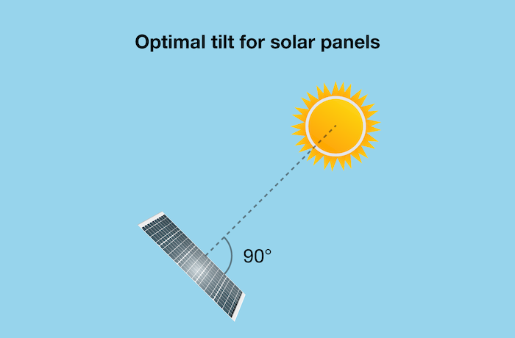
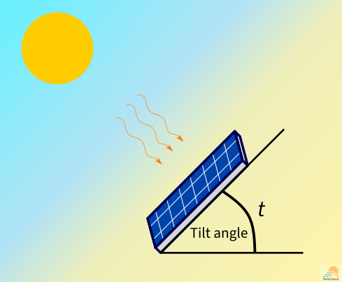
Why Do We Tilt The Panels?
To capture the maximum amount of energy, solar panels can be tilted so that incoming light is perpendicular to the panel.
The best angle for panels to be at depends on
how far you are from the equator (latitude)
the time of year
the time of day

Slide 14
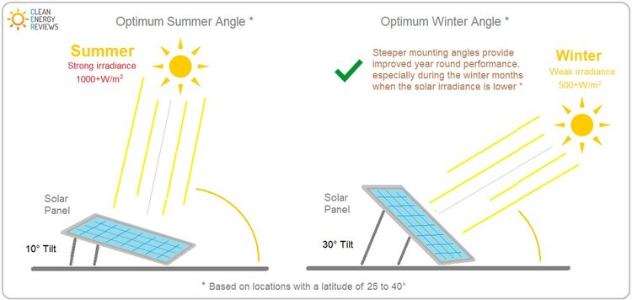
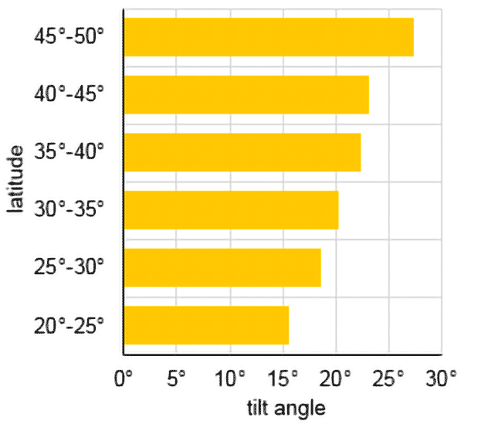
What Angle Should The Panels Be At?
The optimal angle in the summer is not the same as the optimal angle in the winter.
The optimal angle will be different at different latitudes

Slide 15
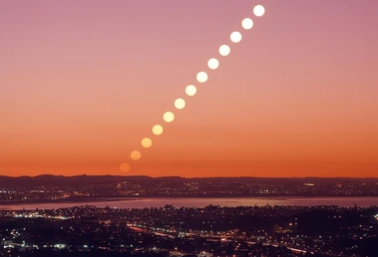
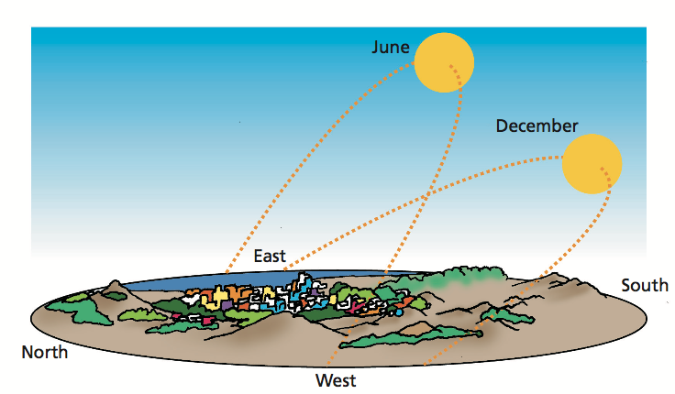
Tilt of the Earth – Effect on Solar Power
No one tilt setting is perfect
Every day the sun rises in the East and sets in the West.
The ideal tilt angle changes throughout the day
In the summer months there is not only more hours of sunlight, the sun rises higher in the sky.
The ideal tilt angle changes throughout the year

Slide 16
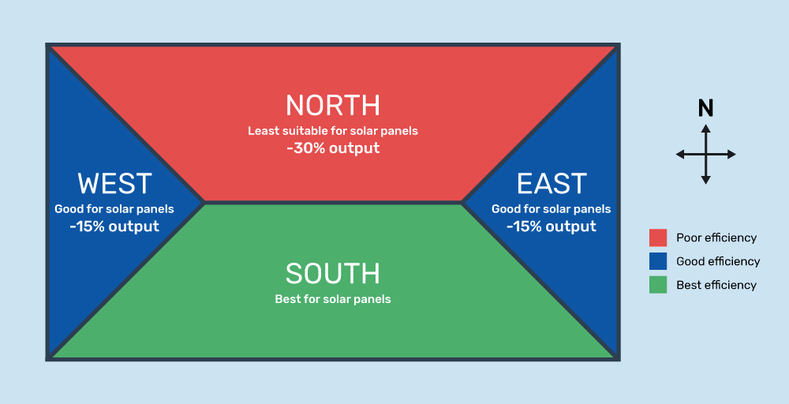
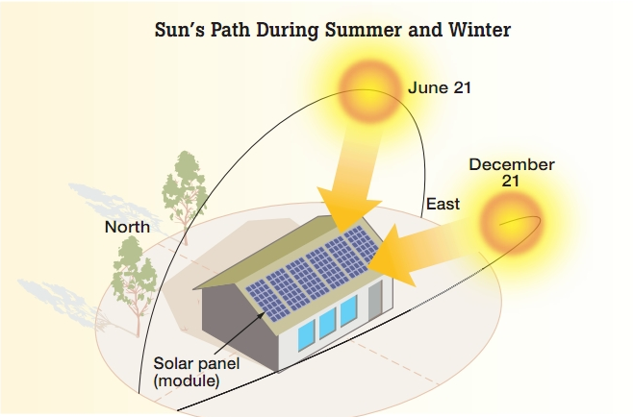
Do solar panels need to face south to work?
No.
A system set up on an east or west roof will produce only 15% less power on average
A north roof, 30% less (but not zero)

Slide 17
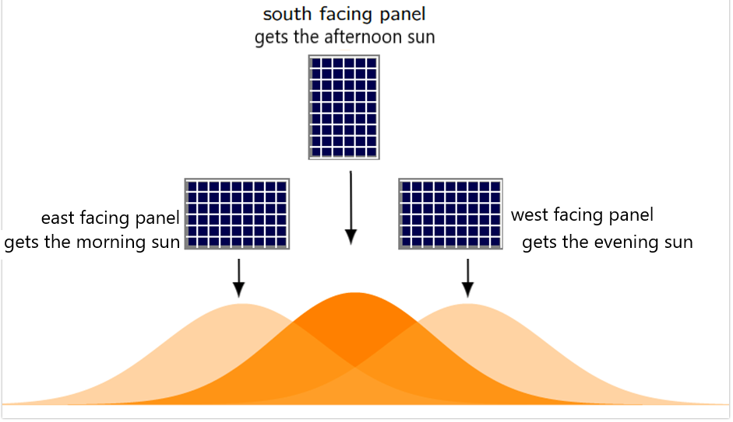
The figure on the right shows how little difference is seen when comparing the power produced from East, South, and West facing Solar Panels.
A system with both east/west panels performs as well as a south facing system of the same size.

Slide 18
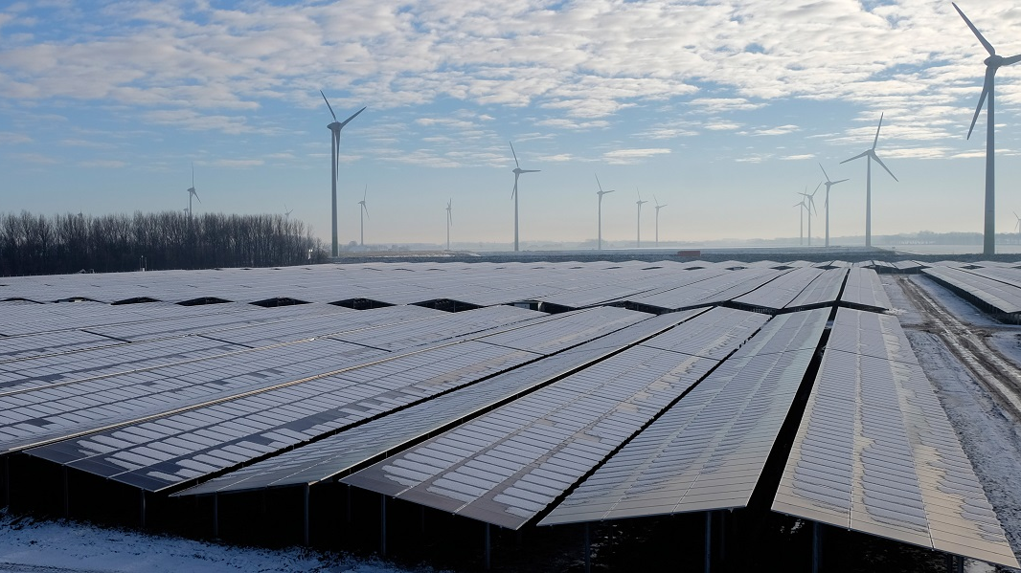
Field or Flat Rooftop Installs all over the world are being put up with East/West pattern
This setup produces a similar amount of power spread over the length of the whole day, somewhat reducing the power usage vs solar power production issue.

Slide 19
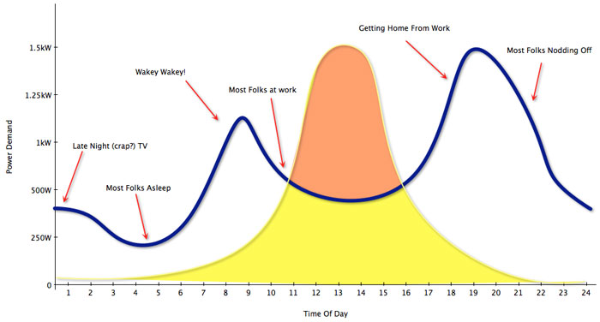
Solar Output is the highest between 11AM and 3PM. Energy Demand is the highest at between 7AM and 10AM and then again between 6PM and 9PM.This does not align! We can’t go 100% solar!

Slide 20
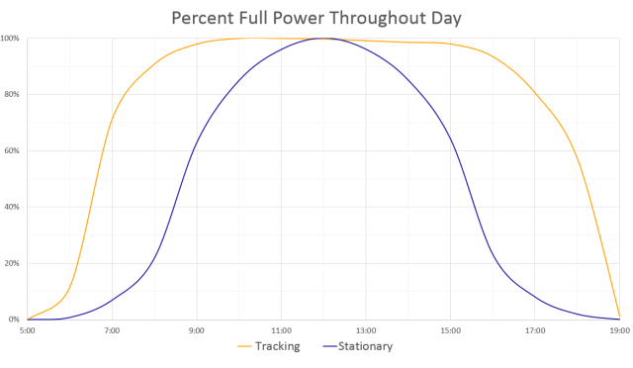
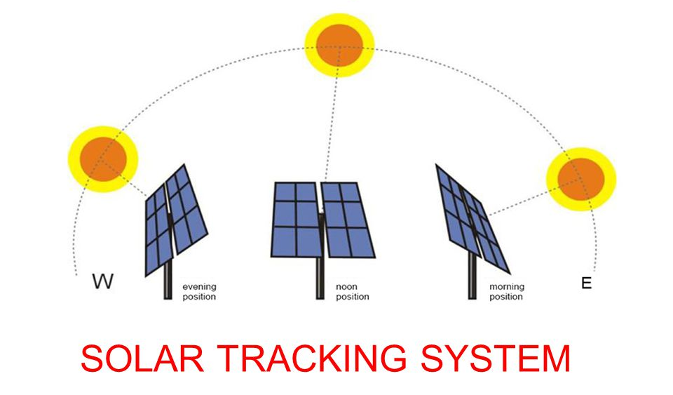
Solar Tracker Technology
Solar Panels installed on a solar tracker system follow the sun as it rises and sets.
The system spins once on its axis every 24 hours, just like the Earth.
Combines the East/West/South Pattern to generate as much as 32% more power.

Slide 21
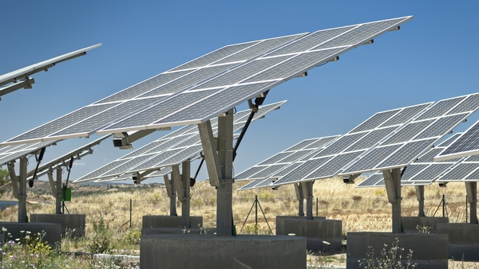
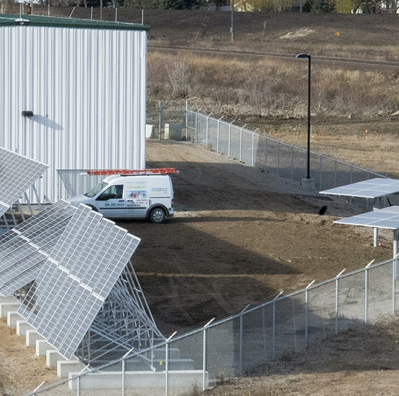
Saskatoon Landfill Solar Demonstration and Research Site
3 Sets of fixed panels at different tilt angles
Goal is to have data to understand the best tilt angle for future installation in Saskatoon
2 single axis solar trackers
Goal is to understand if tracker technology produces the additional energy it claims to

Slide 22
Why is the SmartFlower so Special?

Slide 23
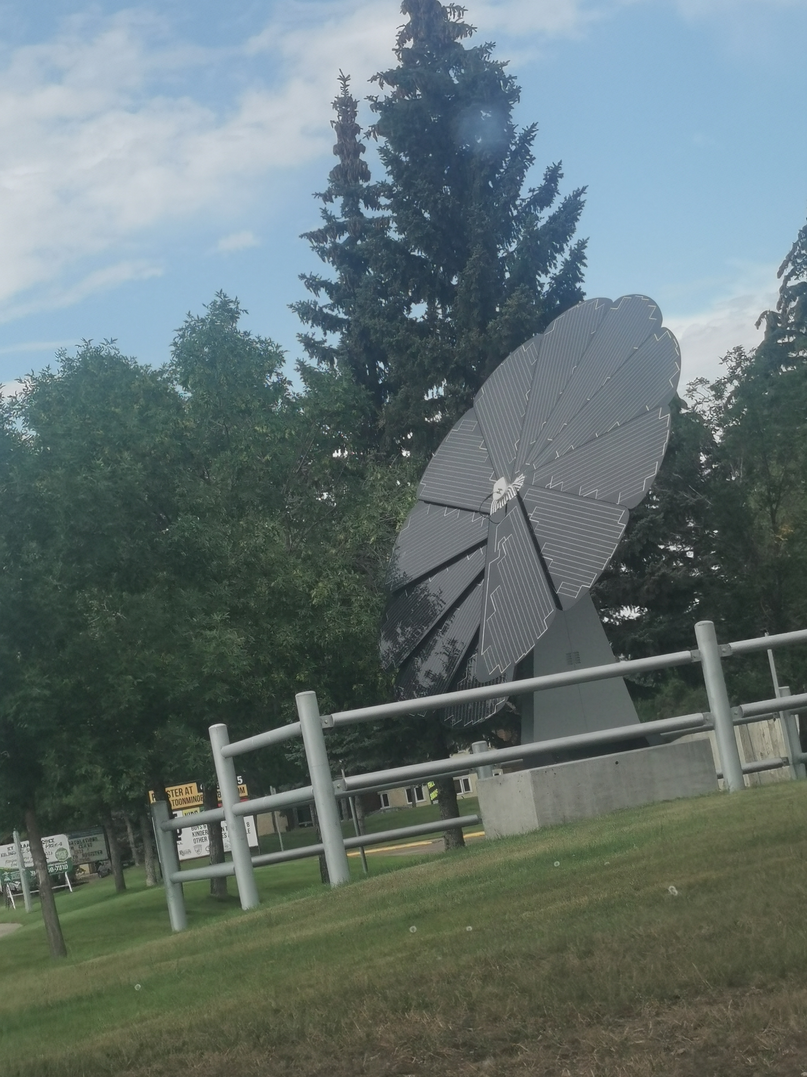
SMARTFLOWER – DUAL AXIS TRACKER @ BJM
Much like a real flower, the system unfolds its petal-panels when the sun rises.
The SmartFlower then directs its petals toward the sun at a 90-degree angle and almost immediately begins to produce renewable energy at maximum capacity.
At sunset, the petals automatically retract until the next morning.

Slide 25
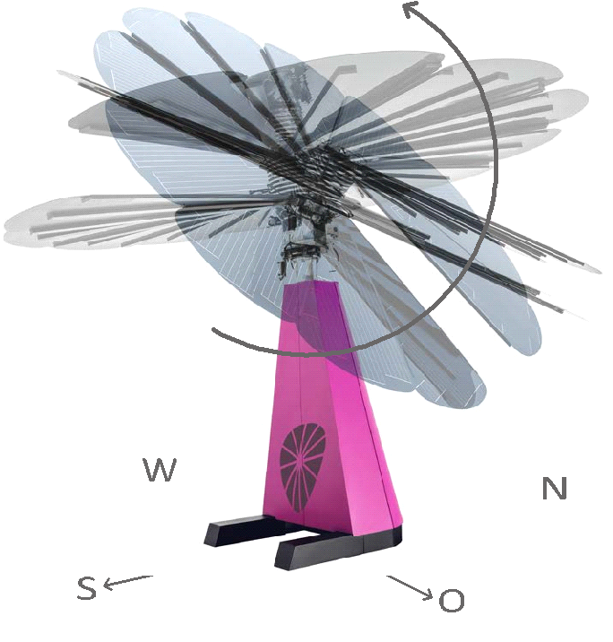
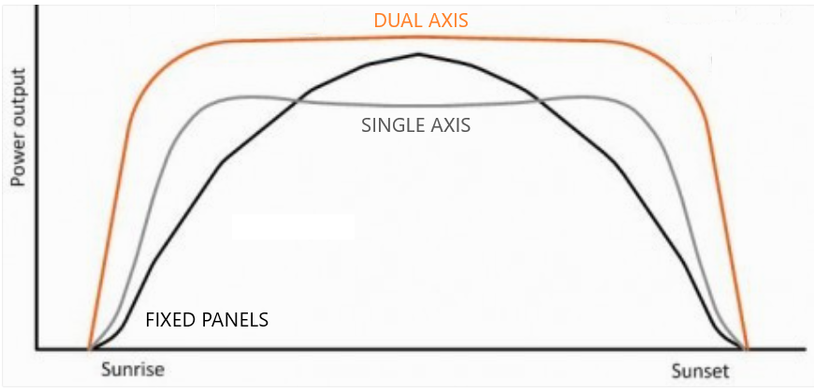
SmartFlower – Dual Axis Tracker
All-in-one solution
Accounts for both changes in the rotation of the Earth and the ideal tilt angle throughout both the day and year
Contains solar tracker technology on one axis
Also has a second axis that tilts the panels to reliably allow for direct radiation at all times of the day.
Produces upwards of 40% more clean energy than a traditional fixed solar panel system.

Slide 26
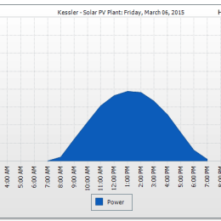
Standard Output from a Solar Panel

Slide 27
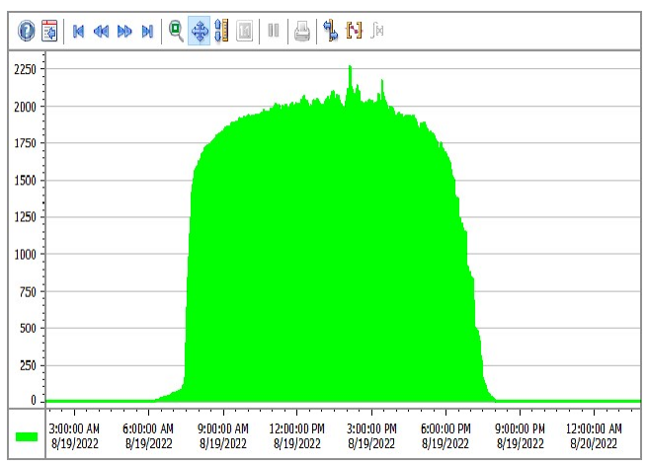
Data Output from BJM SmartFlower 40% more power produced than compared to a standard, stationary, solar panel tilted properly Shape of the curve is no longer bell shaped.

Slide 28
Biome Connections of Solar Angle – Qu’Appelle Valley

Slide 29
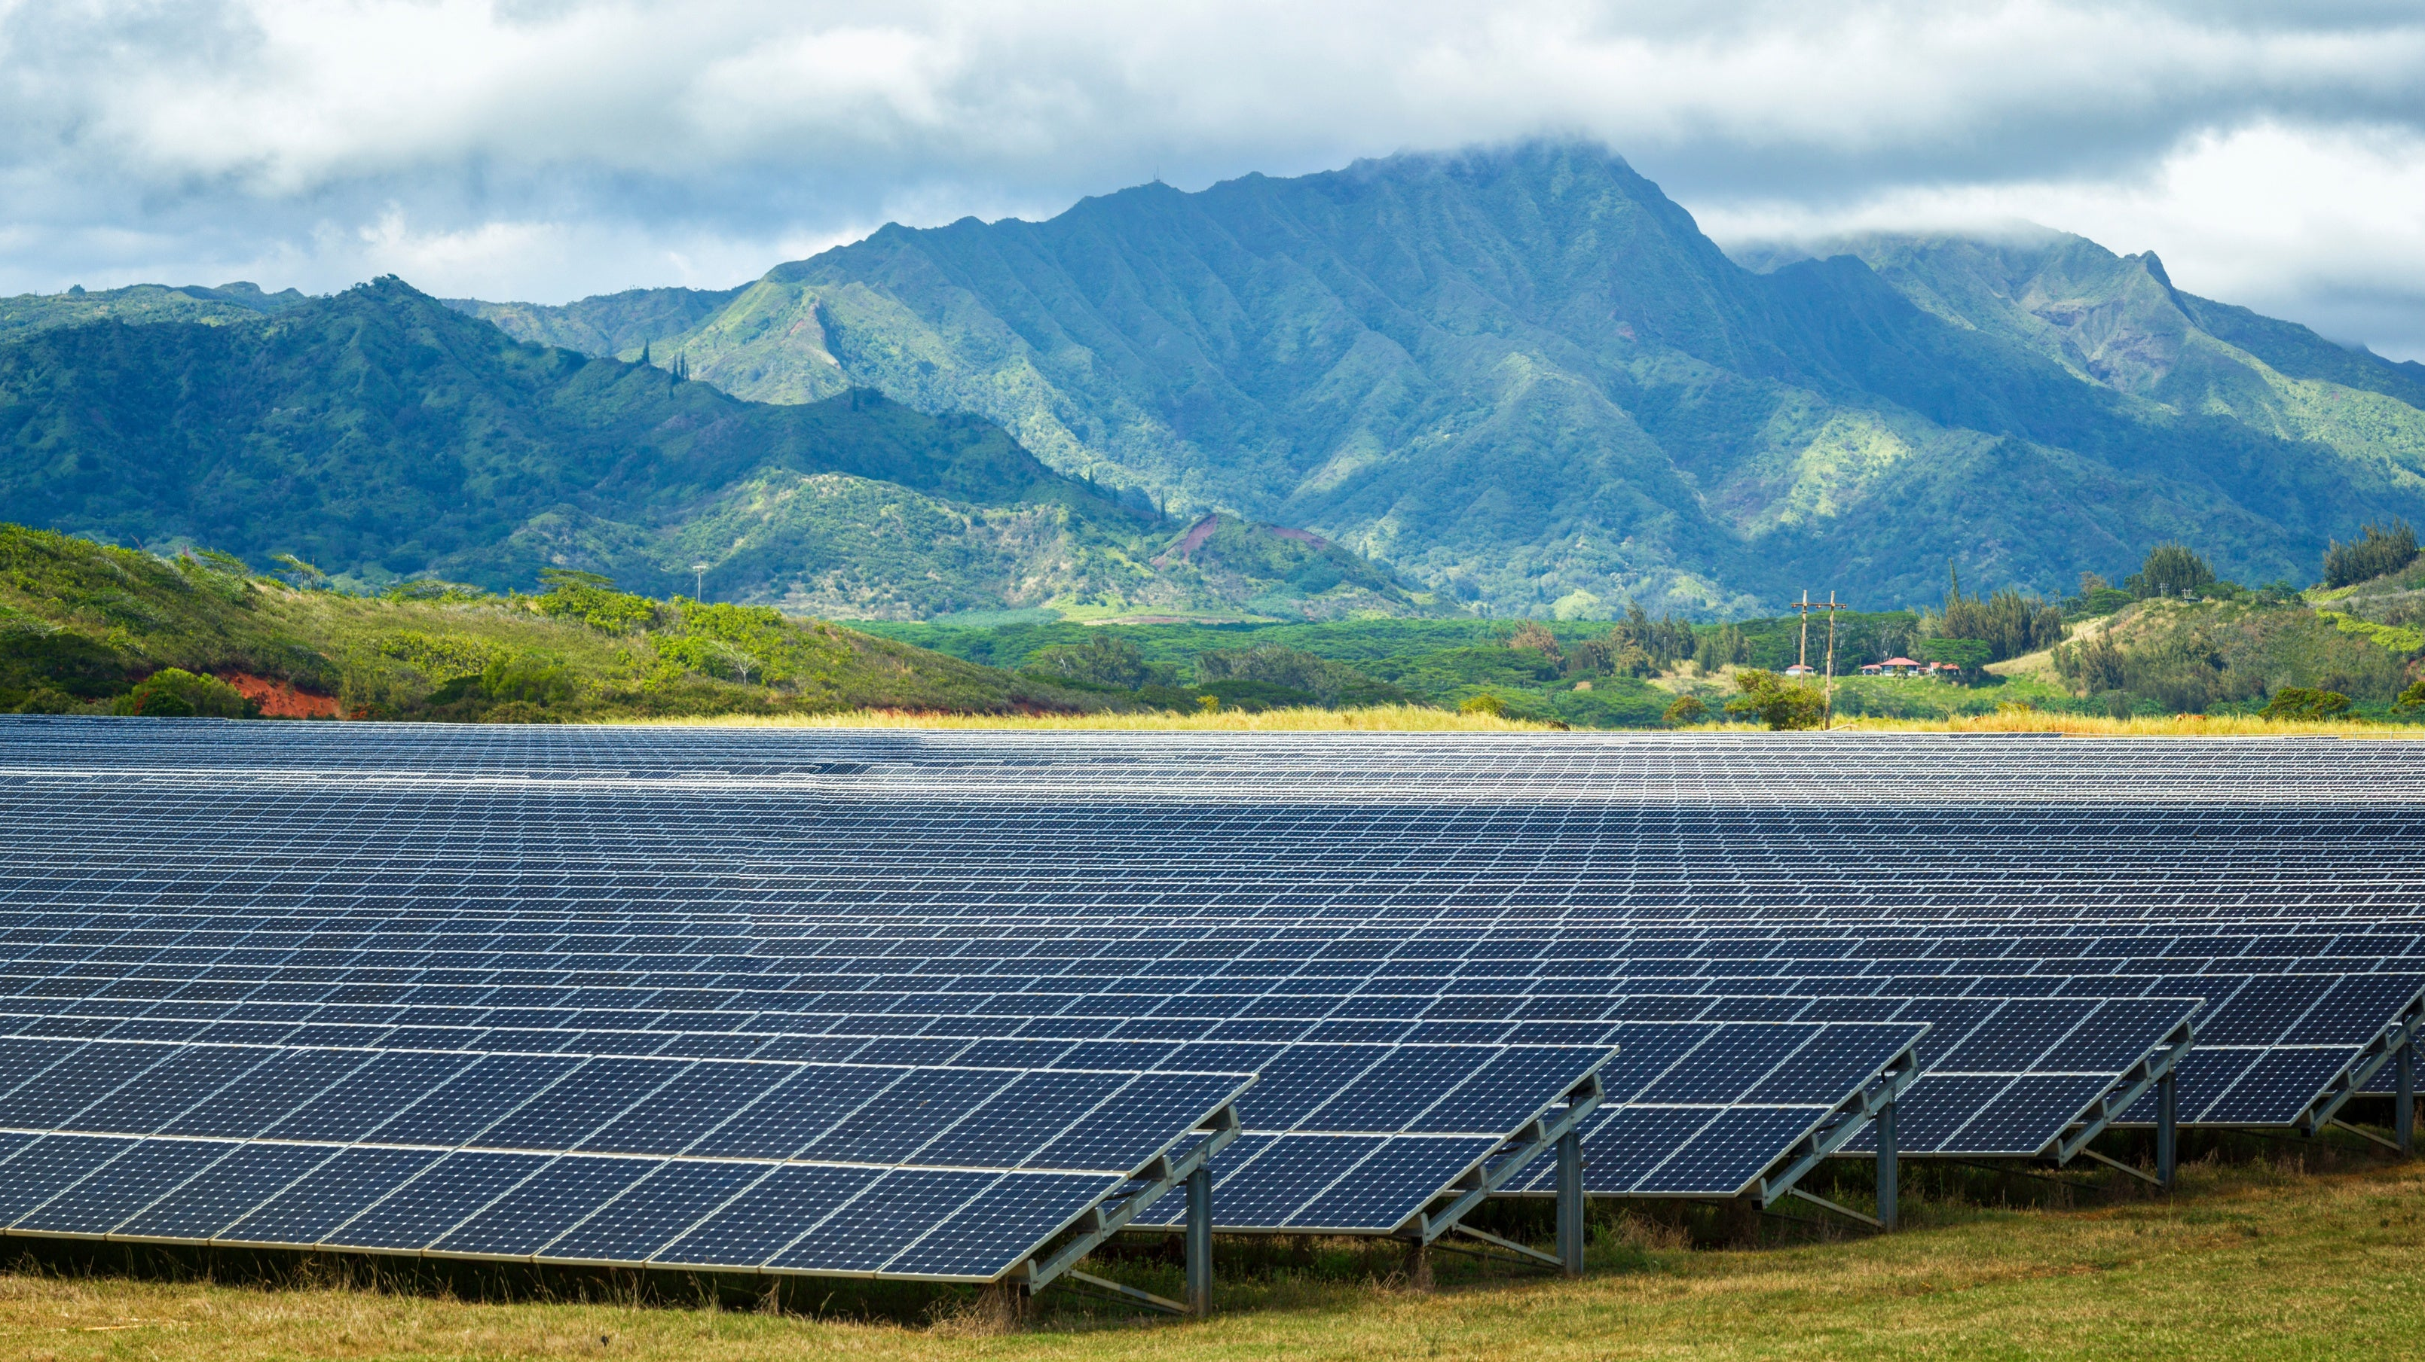
Can we go 100% Solar anywhere on Earth?
Closer to the equator (between the tropic of Cancer and Capricorn) the amount of sunlight remains more consistent
Ex. Honolulu’s has 13:26 of sun June 21 and 10:50 of sun December 21
Hawaii will be the first US state to aim for a 100% solar power grid paired with battery technology without a need for a baseline grid.
40% of global population lives in the tropics
A trend for the future!?

