Slide 1
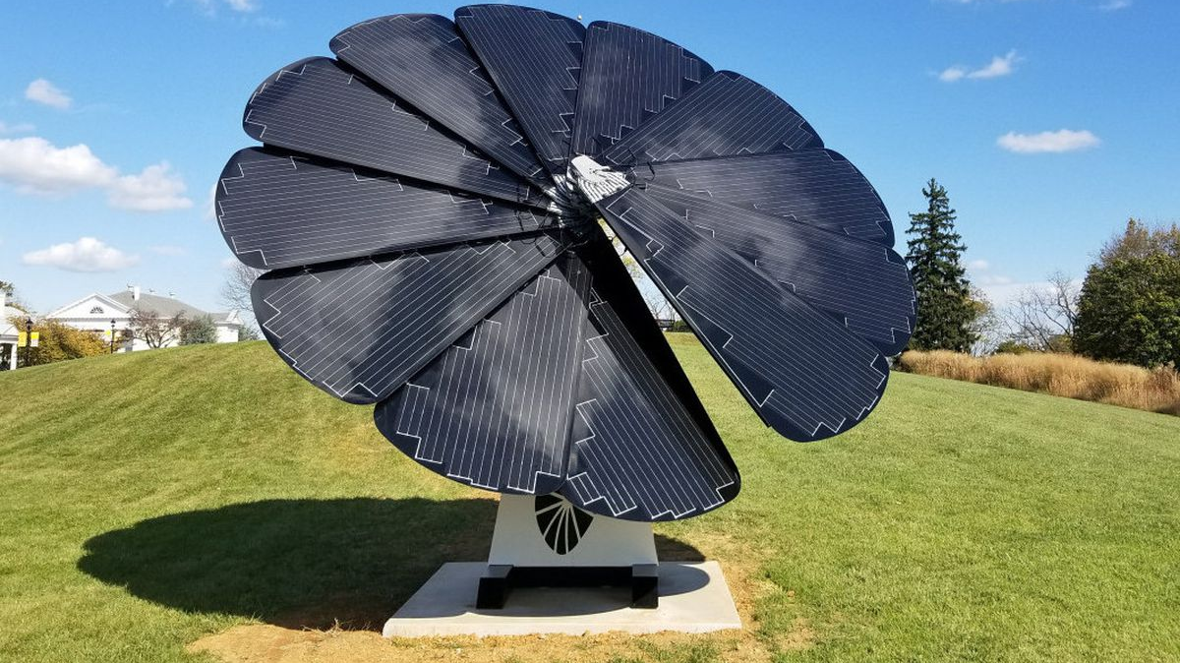
Solar Technology and the SmartFlower @ BJM High School
Developed for Chemistry 30
How do Solar Panels make Electricity?

Slide 2
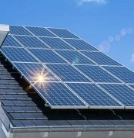
Photovoltaic Cells
A photovoltaic (PV) cell is an energy harvesting technology that converts solar energy into electricity
This is accomplished through a process called the photovoltaic effect.
There are several different types of PV cells which all use semiconductors to interact with incoming photons from the Sun in order to generate an electric current.

Slide 3
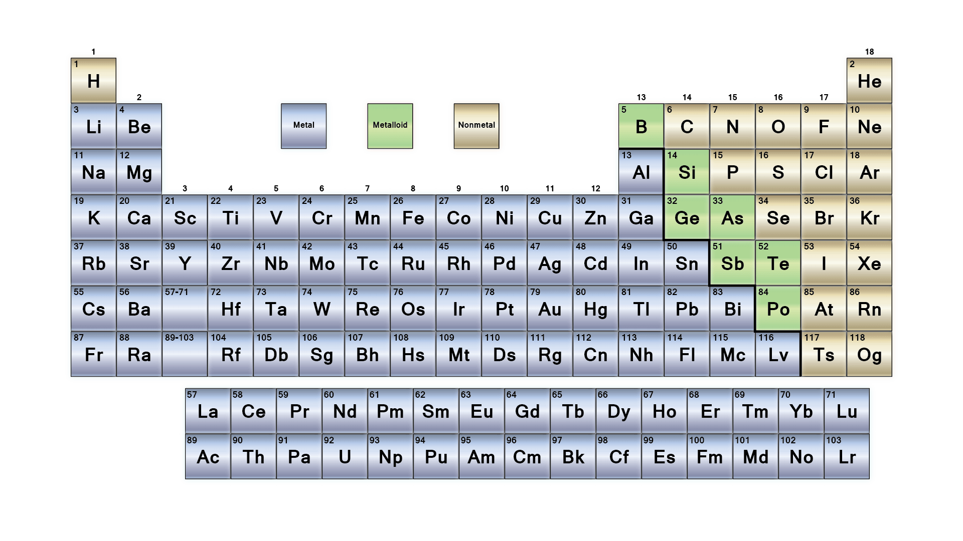
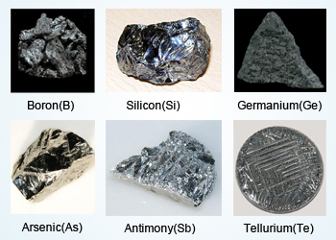
Semiconductors
Elements that make up semiconductors are found near the ‘staircase’ that separates metals and non-metals
Most metals are substances that conduct electricity and are called conductors
Most non-metals are substances that do not conduct electricity and are called insulators
Metalloids are substances with properties somewhere between them and most metalloids are semiconductors

Slide 4
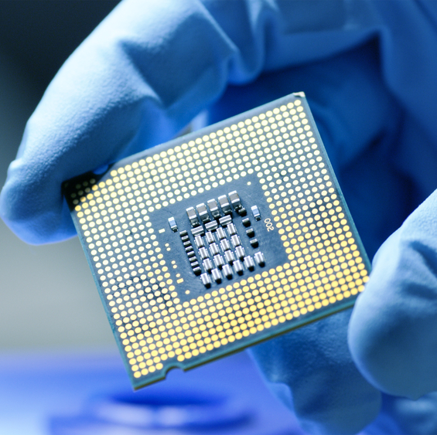
Semiconductors
Integrated circuits (computer chips and processors), diodes, and transistors are made of semiconductors.
The semiconductors within them are often made of silicon or germanium.

Slide 5
Most Solar Panels are Made of Silicon

Slide 6
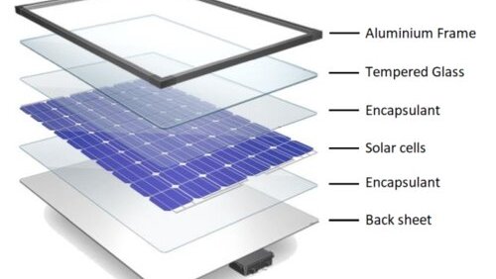
Parts of a Solar Panel
Encapsulant is used to prevent the panels exposure to oxygen, moisture, UV rays, and to control temperature
All things that could reduce the lifetime of the solar cells by increasing the rate of corrosion of the components
Note: The parts of a solar panel are 90% recyclable by mass

Slide 7
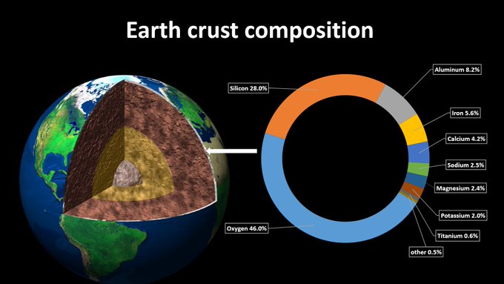
Silicon has HUGE availability!!
The Earth’s crust is the top 1% of the Earth
the surface of the Earth
59% of Earth’s crust is silica (SiO₂), 28% silicon.
Silica does not require difficult or expensive mining, drilling, or extraction procedures.
Usually available as a biproduct of other mining processes that are already done.

Slide 8
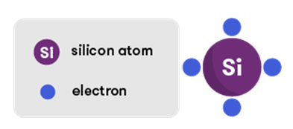
Silicon and Valence Electrons
Most Photovoltaic cells are made of silicon
Silicon has 4 valence electrons and likes to form four covalent bonds

Slide 9
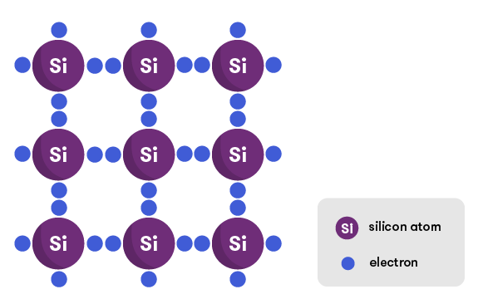
Silicon Crystal Lattice
In a sample of pure silicon atoms it can form a tightly knit crystal structure that involves the formation of 4 perfect covalent bonds with other silicon atoms.
This bonding pattern leaves few (or no) free electrons floating about.
To make electricity we need to have a flow of free flowing electrons, so this cannot create electricity.

Slide 10
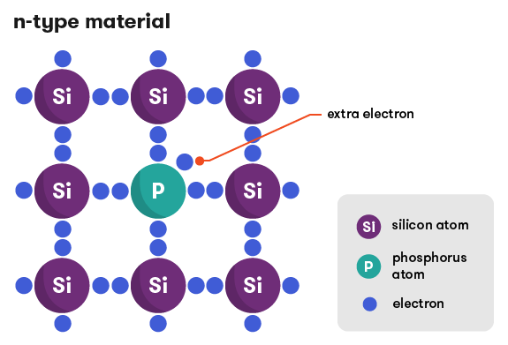
How Solar Panels Make Electricity
Pure silicon can’t create electricity so we ‘dope’ it with other atoms
N-type doping of a silicon crystal - When a silicon crystal forms with a small amount of phosphorus present the phosphorous gets included in the crystal lattice.

Slide 11
How Solar Panels Make Electricity
Since phosphorous has 5 valence electrons it has a free floating electron that can’t bond within the silicon crystal.
The ‘doped’ silicon becomes a semiconductor of N-type (negative, with an extra electron)

Slide 12
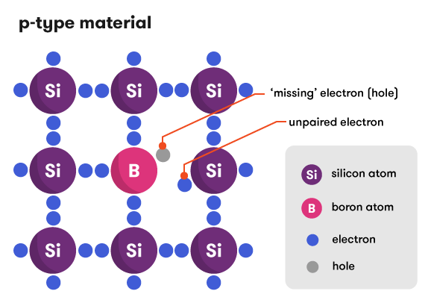
How Solar Panels Make Electricity
Pure silicon can’t create electricity so we ‘dope’ it with other atoms
P-type doping of a silicon crystal - When a silicon crystal forms with a small amount of boron present, the boron gets included in the lattice.

Slide 13
How Solar Panels Make Electricity
Since boron has 3 valence electrons it has an electron hole and can’t bond with all 4 silicon atoms in the crystal.
The silicon becomes a P-type semiconductor. P = positive (missing an electron)

Slide 14
A P-N Junction
Most solar cells consist of two layers.
A P-type silicon semiconductor can be placed on top of N-type silicon semiconductor
There is a transfer of electrons into the holes, creating and electron-hole pair
Electrons can only flow in one direction

Slide 15
Is Electricity Created?
NO!
Over time the holes will be filled with electrons and the electrons from the N-type will be depleted.
Electrons will stop flowing
Similar to a battery, a P-N Junction does not do work on its own.
Both need an external circuit so that electrons can flow
A semiconductor is not a source like a battery though
We need to find a way to excite electrons so that they will conduct electricity!

Slide 16
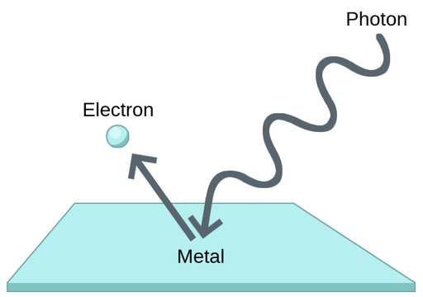
Photoelectric Effect
In 1905, Albert Einstein noted that when a material is exposed to photons of light it absorbs the light and gives off electrons
This was called the photoelectric effect. (Einstein won the 1921 Nobel Prize for this discovery)

Slide 17
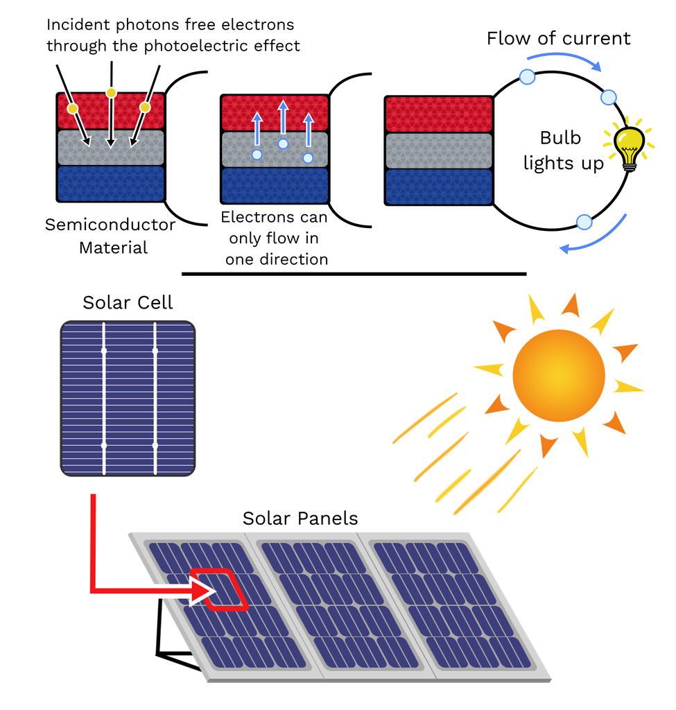
Photoelectric Effect and Photovoltaic Effect
In the photoelectric effect, electrons are ejected from the material and no work can be done.
If the excited electron is not ejected from the material but rather flows through the material then it is called the photovoltaic effect.
If that flow is harnessed to do work then we can create electricity

Slide 18
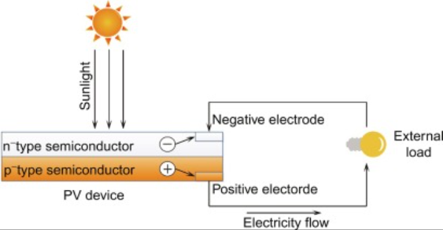
How do Solar Cells Work Exactly?
When the silicon atoms absorb light, electricity generation begins.
Photon energy knocks some electrons out of the atoms (photoelectric effect).
This causes them to migrate from the negative n-type layer to the positive p-type layer.

Slide 19
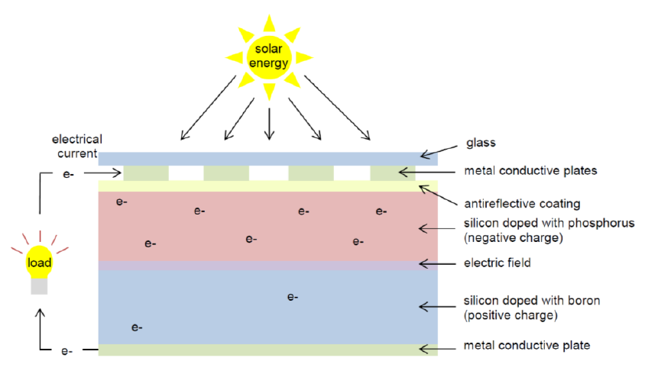
How do Solar Cells Work Exactly?
This migration (movement) of electrons through the P-N Junction makes an electric field.
A solar cell usually has metal contacts on its tops and bottoms. Electric current flows out of these metal plates and into an external circuit.
The electricity, in direct current form, can then leave the solar cell through the metal contacts and be utilized by devices that can operate on direct current.

Slide 20
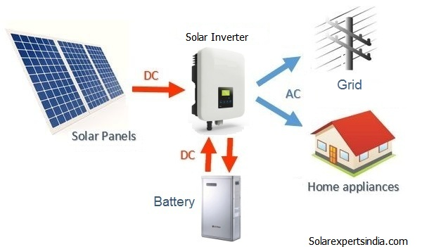
AC/DC?
In order to power your home’s devices, the DC (Direct Current) electricity is then converted to AC (Alternating Current) electricity using a device called an inverter.
The AC electricity can then be used to power your home’s electrical devices

Slide 21
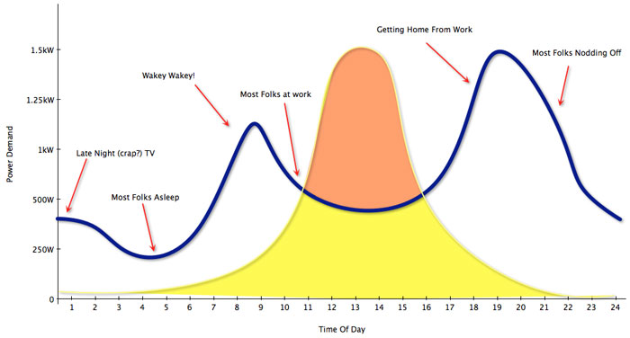
The Need for Battery Storage of Generated Solar Power
Solar Output is the highest between 11 AM and 3 PM.
Energy Demand is the highest between 8 AM and 10 AM and then again between 6PM and 9PM.
This does not align!

Slide 22
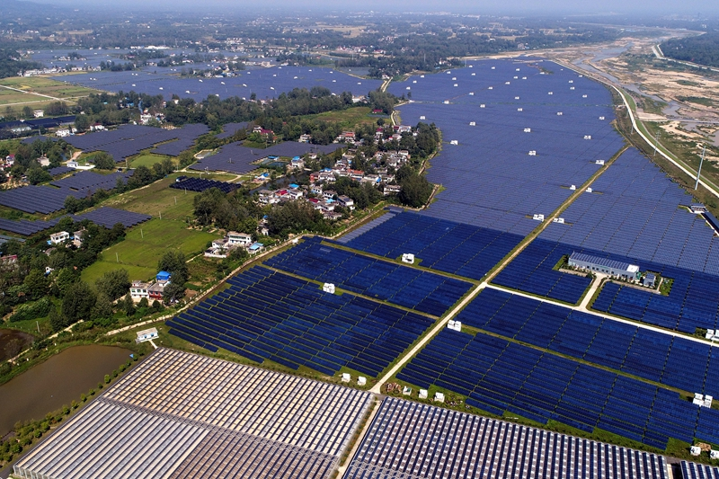
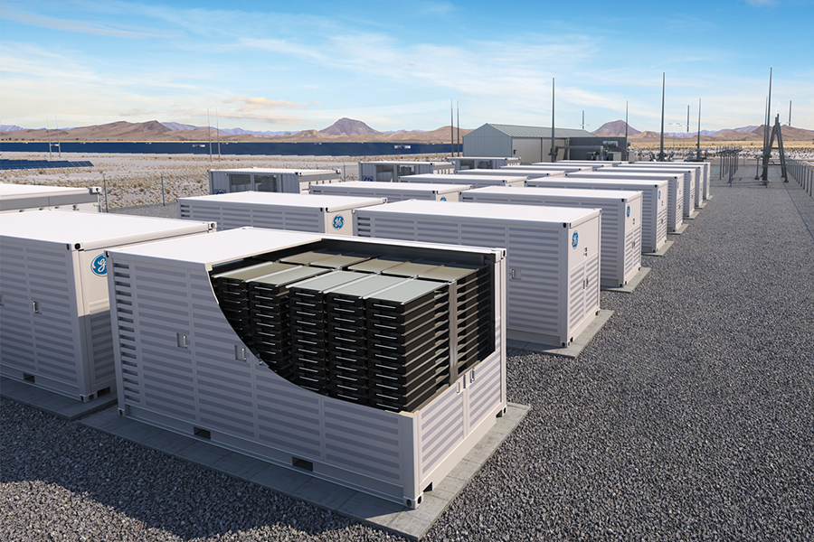
The Need for Battery Storage of Generated Solar Power
Fields of Solar Panels need substantial battery storage.

Slide 23
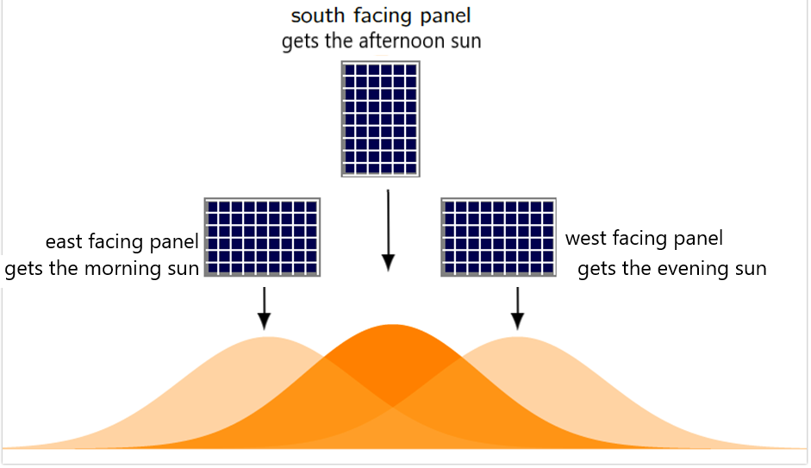
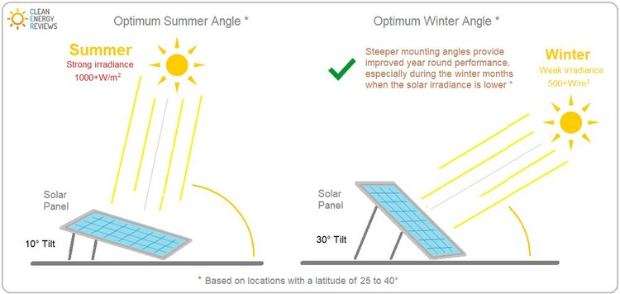
SmartFlower Widens the Power Production Window with its DualAxis Tracking Technology
Stationary Solar Panels
Point in only one direction
Are installed at a specific tilt angle

Slide 24
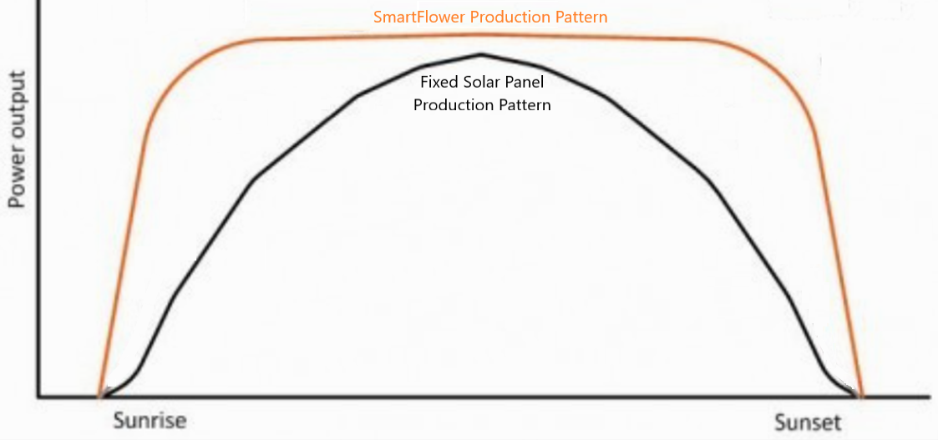
SmartFlower Widens the Power Production Window with its DualAxis Tracking Technology
Dual Axis Tracker
SmartFlower tilts and rotates to follow the sun

Slide 26
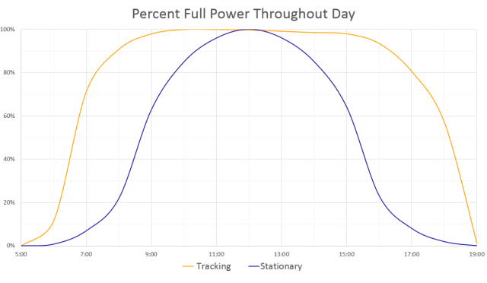
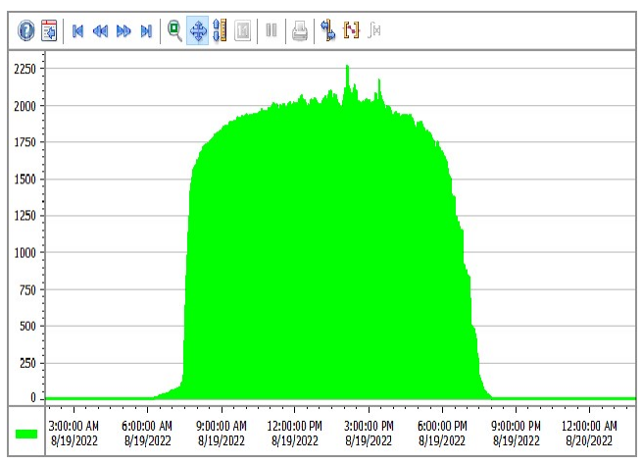
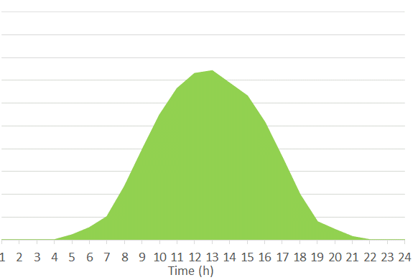
Sunny Day Data Output from BJM SolarFlower Compared with Stationary Solar Cell Output
June 26th, 2022 (SmartFlower @ BJM) Stationary Solar Panel Output (external source)
The area under the curve will be equal to the amount of power produced.

Slide 27
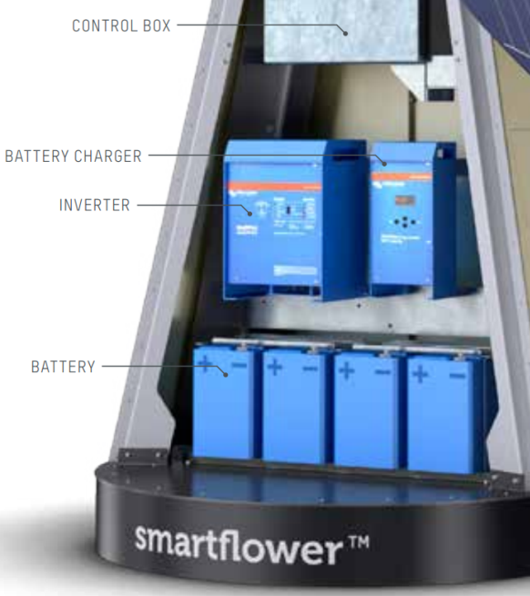
SmartFlower – The All-in-One Solution
To combat the problem of energy usage not aligning with solar energy production the SmartFlower is equipped with its own integrated battery storage system
The energy stored in the batteries can be used at peak usage time if solar production is lower than demand.
It also has its own battery charger and control box.
These components would usually be installed inside of the building it would be trying to power.

Slide 28
SmartFlower – The All-in-One Solution
Solar panels also create DC (direct current) that must be changed to AC (alternating current) by an inverter
The SmartFlower is equipped with an AC/DC inverter within the structure itself
This component would usually be installed inside of the building it would be trying to power.
Often requiring engineers to create plans for wiring around existing infrastructure and electricians to install

