Slide 1
Technology in Canada Today
Social structures that give rise
to what we use
Notes:
Key Questions:
What do you think of when the word technology comes to mind? (fill the board with student responses)
How many items can you name from this photo alone? Inquire and extend if they know how if this technology has improved today, and in what form is it in now? Also inquire if they know what it looked like and functioned like in the form before what is presented*

Slide 2
Social Structures
What areas of our lives aid in the development and support of new technologies?
Notes:
Discuss the role of government, research, and environmental research today* (teacher notes)

Slide 3
Social Structures
What areas of our lives aid in the development and support of new technologies?
Notes:
Discuss the links of education and economic structures in the development of new technology and research (teacher notes)

Slide 4
Social Structures
What areas of our lives aid in the development and support of new technologies?
Notes:
Discuss the links from public interest, social interest, leading to investors and currency flow to push for new developments (teacher notes)

Slide 5
Social Structures
What areas of our lives aid in the development and support of new technologies?
Notes:
Discuss the role of communication, interrelation, and the importance of new ideas leading to new technologies and possible ways of living in Canada (teacher notes)

Slide 6
What technologies do you use or rely on everyday?
Do you see a connection between what you use and value everyday to the worldview expressed in Saskatchewan?
If so, in what ways does our technology reflect our culture, geography, politics, etc.?
If not, how so?
Notes:
Make a list and discuss. This discussion should be getting students mentally in the frame of mind to select a possible technology for their preliminary research.

Slide 7
Task
Pick your TOP THREE technologies you have been thinking of and write them down.
Once you have your list, ask yourself the following and record any information you know or are wondering:
- How did these technologies begin? Who developed the idea? Who funded the production? Is this a better form of an older technology? How can this technology be improved? What other areas of society allowed this product to be created for public consumption?
Using the computers to research, try and discover as much as you can about your top choices above and RECORD your information on loose leaf as well as on a word document or program of choice**

Slide 8
Helpful Stating Points ☺
https://saskatooniec.ca/ (Saskatoon Industry Education Council)
here, you can explore current research and initiatives in Saskatoon and SK, as well as explore the sectors for careers that aid in development of new technologies
https://www.siemens.com/global/en.html (Siemens website to explore and gain interest and explore)
https://innovationsask.ca/technology (Innovation Saskatchewan website)
https://thinksask.ca/invest/technology (thinksask website)
- Some stories of innovators in technology in SK as well as links to a variety of topics
https://wdm.ca/special_feature/saskatchewan-innovations/ (list of patents of technologies made in SK from 1905-1980 for curiosity)

Slide 9
End Day 1

Slide 10
Collaboration Time!
We will now take some time to share some of the ideas, information and details that came from our research time on our top three technology selections.
Pick the one you found yourself most interesting to share about and we will learn from one another before moving on.
Notes:
Time for this varies on class activity*

Slide 11
Technology in our lives today
The following is a presentation on a SPECIFIC technology that is of interest to us here at Bishop James Mahoney in Saskatoon. This presentation will be an exemplar for your final project for social studies 90 so please pay close attention, ask questions as necessary, and let’s get started!

Slide 12
Focus Questions for this presentation
What does the Smartflower actually DO for us here at BJM?
How many aspects or areas of our society today were needed for the Smartflower to be installed and implemented at BJM?
Notes:
Try and make a list on the board of all the careers, partners, and jobs utilized to develop, install, and run the microgrid in our classrooms**

Slide 13
Smartflower
An indicator to the future of microgrid energy storage and use through solar energy.
Notes:
Click the title for the youtube link (~1:50 news clip)

Slide 14
Highlights
What the Smartflower does
Partners Involved
Other Careers and Research
Where is this Going?
Climate Change Competition

Slide 15
What the Smartflower does for SK
Province
city
Demonstrates a commitment to solar energy and sustainable energy use, and other ‘green’ technology
Makes us a leader in showcasing possibilities of microgrids directly in our communities
Demonstrates leadership in new and innovative directions to provide sustainable energy
Displays partnerships between levels of education and society
Encourages students to see the diverse range of careers and occupations needed to create the world around us
Notes:
Student notes

Slide 16
Functions of the Smartflower at BJM
Draws in solar energy and converts it to electrical energyusing an AC inverter (potential power is 2500 watts – think of 25 100 W bulbs)
Electrical energy is stored in a battery when not in use (most storage is for it’s own continued function in case of emergencies)
Can provide energy to run the classroom lights, electrical devices, and can provide energy for labs that would have otherwise been drawn from the city services
Provides authentic learning opportunities to students through either monitoring the power provided or using it directly
If the power goes out, the grid will operate independently
Brings attention from the public through a beautiful design
Notes:
Student notes

Slide 17
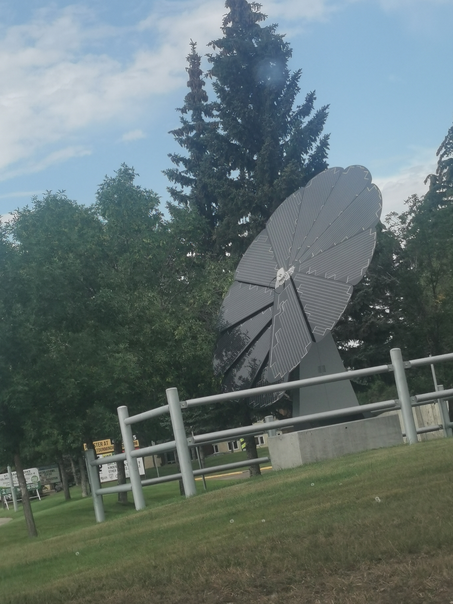
SMARTFLOWER – DUAL AXIS TRACKER @ BJM
Much like a real flower, the system unfolds its petal-panels when the sun rises.
The SmartFlower then directs its petals toward the sun at a 90-degree angle and almost immediately begins to produce renewable energy.
At sunset, the petals automatically retract until the next morning.
Notes:
Student notes

Slide 18
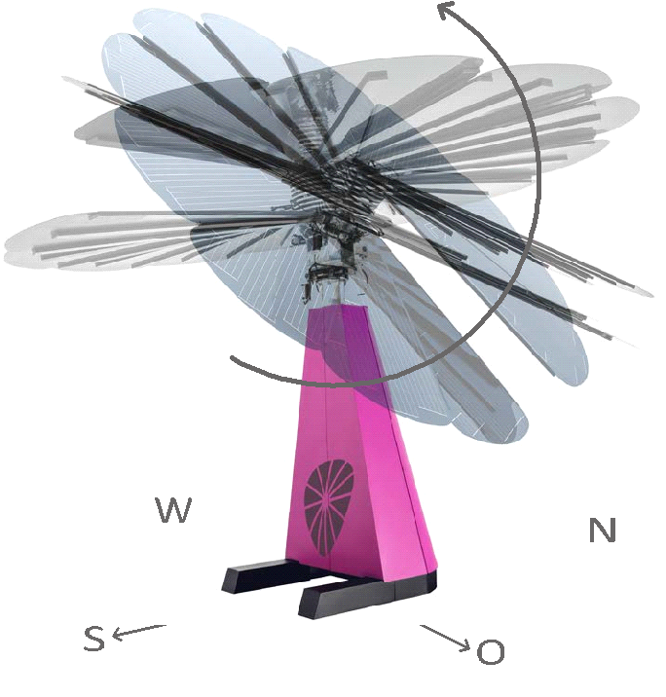
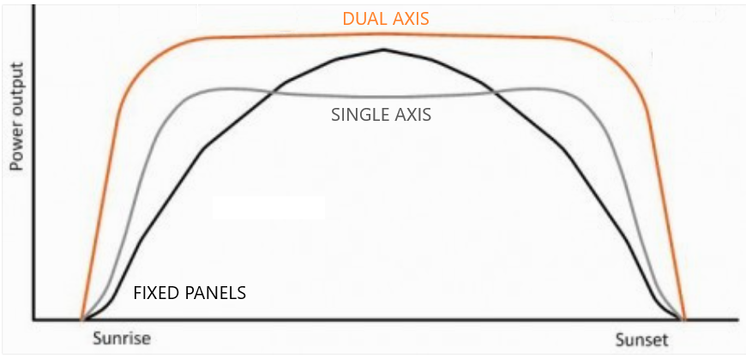
SmartFlower – Dual Axis Tracker
All-in-one solution
Accounts for both changes in the rotation of the Earth and the ideal tilt angle throughout both the day and year
Contains solar tracker technology on one axis
Also has a second axis that tilts the panels to reliably allow for direct radiation at all times of the day.
Produces upwards of 40% more clean energy than a traditional fixed solar panel system.
Notes:
Student notes

Slide 19
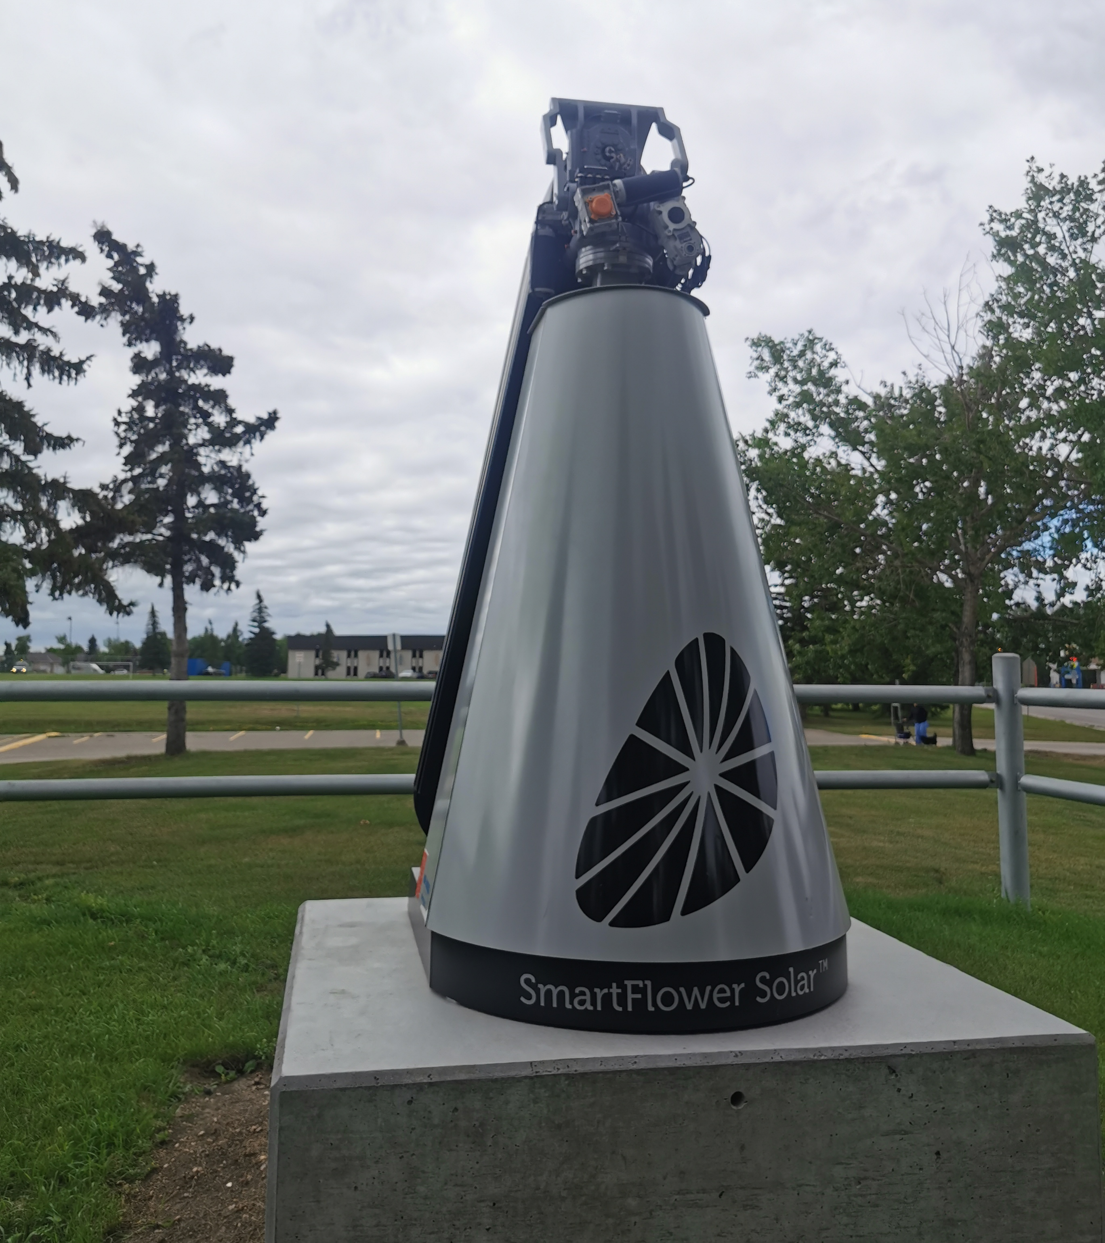
SmartFlower – Extreme Weather
To prevent weather damage, the SmartFlower is designed to do the following
There is a light sensor
At sunset, the flower petals retract until the next morning.
There is a wind gauge
In high winds (above 50km/hr) the flower petals retract
When closed the system can withstand hurricane force winds
Notes:
Student notes

Slide 20
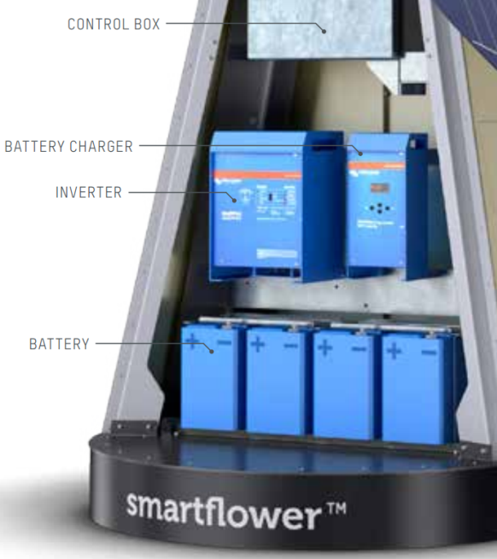
SmartFlower – The All-in-One Solution
To combat the problem of energy usage not aligning with solar energy production the SmartFlower is equipped with its own integrated battery storage system
Solar panels also create DC (direct current) that must be changed to AC (alternating current) by an inverter
The SmartFlower is equipped with an AC/DC inverter within the structure itself
It also has its own battery charger and control box. These components would usually be installed inside of the building it would be trying to power.
Notes:
Student notes

Slide 21
Partners for a more sustainable life
SIEC
Siemens Canada
GSCS
Saskatchewan Industry Education Council
Greater Saskatoon Catholic Schools
Notes:
Hyperlinks to company websites in names for further exploration if desired**

Slide 22
Partners for a more sustainable life
Graham Construction
Humboldt Electric Limited
Innovation Saskatchewan
Notes:
Hyperlinks to company websites in names for further exploration if desired**

Slide 23
Timeline for the BJM Smartflower
Jan. 2021 - Siemens
Developed the technology for the Smartflower and looking for an interested non-profit organization in Canada to coordinate with
Spt. 2021 - SIEC
Joined Siemens in the project and began looking for local partners hat would be willing to undertake the project
Oct. 2021 - GSCS
Partnered with Siemens and SIEC. BJM was chosen as the location and developers needed to be hired to progress the project
Nov. 2021 - Graham
Nov. 2021 – Humboldt Electric
Hired to plan and organize the Smartflower with Graham to ensure it runs and operates properly
Hired by SIEC and GSCS to lay the foundation and construct the Smartflower in conjunction with the City of Saskatoon and other partners
Nov, 2021 - Innovation Saskatchewan
Partner to aid in financial and organize setup of construction at BJM
Notes:
*need information on who and when for partnerships*
- Also need to make reference sheet with more details for teachers to expand on roles and information presented here*

Slide 24
Timeline for the BJM Smartflower
June 2022
September 2022
Siemens came back after the foundation, general construction, and electrical were completed to specifications
Siemens programmed the Smartflower and tested it until its programs were up and running optimally
Summer of 2022 was used as a testing time to ensure the Smartflower was fully operational
The official ‘unveiling’ of the Smartflower at BJM in Saskatoon, SK
CJWW
Global News
StarPhoenix
CTV News
Notes:
Links to news articles are in the names for viewing as interested

Slide 25
Careers and Educational Backgrounds
As you have seen, there is a variety of educational and skill-based jobs and careers needed to install the Smartflower at BJM.
Directors, boards of companies, multiple partners of communication, engineers (electrical, mechanical, computer software), construction, electricians, media, city planners, government officials, teachers, etc.
Are any of these areas something you would be interested in pursuing?

Slide 26
Where can this technology take us?
Solar applications and technology has been a growing area since it’s conception and will only improve
Initiatives worldwide are pushing for less and less reliance on fossil fuels to help battle climate change, and this technology helps decrease our reliance
Aids in pushing the boundary and technology to harness more of the suns’ energy and increase the draw and output of solar panels. This would produce more researchers, scientists, and jobs for SK*
Might get more investors and local initiatives to install more Smartflowers (on rooftops for example) in communities and provide energy where it can be used effectively
Might be a possible solution for more power production as our government and society push for a more electric power based world (example: initiative that by 2035, no gas powered vehicles will be sold in Canada: problem is that our current power grids are not set up to handle this increase*)
Your ideas??
Notes:
- Discuss any student ideas of what they can think of*

Slide 27
Alternative forms of (micro)grids in SK
Geothermal homes
Windmills at the wdm
Biomass
Large scale plant to be started in 2025 that will be able to power up to 140 MW of power for up to 30 years
Would offset carbon dioxide emissions equivalent to 85000 cars annually
Saskatchewan has three facilities that produce a total of 241 MW to the provincial grid (as of 2021)
Wind farms must be strategically placed and researched before building, and the recycling of these windmills is an environmental issue currently
Utlizes burning natural resources (typically wood) to generate heat to turn turbines. Relatively expensive, but considered carbon neutral
*FYI: A 1 MW plant could power 1200 homes*
Notes:
Links to websites in the titles*

Slide 28
Summary
The Smartflower at BJM represents a full partnership from the governmental initiatives to battle climate change to the ground level student learning about solar energy and what that energy can be used for. From the SIEC, Siemens, the GSCS partnerships, and the many other partners that helped install the Smartflower at BJM, it continues to be a beautiful display of technology that can pave a better future for our society.

Slide 29
Exit Slip
Please hand in your answers to the two focus questions ☺

