Slide 1

Empathy

Slide 2

Empathy

Slide 3
How have online platforms changed your friendship group?
Traditionally youth have a “best friend” 1 person or sometimes a small group of 2 or 4 Bff’s and family members are also usually part of this group
Classmates, teammates, and new friendships are naturally made through school and experiences. This group is considered acquaintances
Friendship groups have evolved due to “online connections” It makes it harder for us to determine who are friends and who are acquaintances. Think about this… Is someone really an acquaintance if you would not talk to them when you see them in person?

Slide 4

Have Social Media Platforms changed the amount of empathy we have?
  The way people portray themselves on Social Media is often not what their real lives are like.
  Insta-lie

Slide 5
Things to consider:
Does this make it harder for us to have empathy when their public life appears to be so great?
Lack of empathy and communicating via social media has increased bullying behaviours

Slide 6

Bullying
Bullying is an ongoing and deliberate misuse of power in relationships through repeated verbal, physical and/or social behaviour that intends to cause physical, social and/or psychological harm. It can involve an individual or a group misusing their power, or perceived power, over one or more persons who feel unable to stop it from happening.

Slide 7

Connected

Slide 8

Cyberbullying
Is defined as “placing an offensive or hurtful public message, image or statement on social media or other public platforms where that message, image or statement can be viewed and/or reposted by others
Liking, sharing, commenting and reposting a negative post about someone has the same if not worse effect as the initial post
Webwise.ie

Slide 9
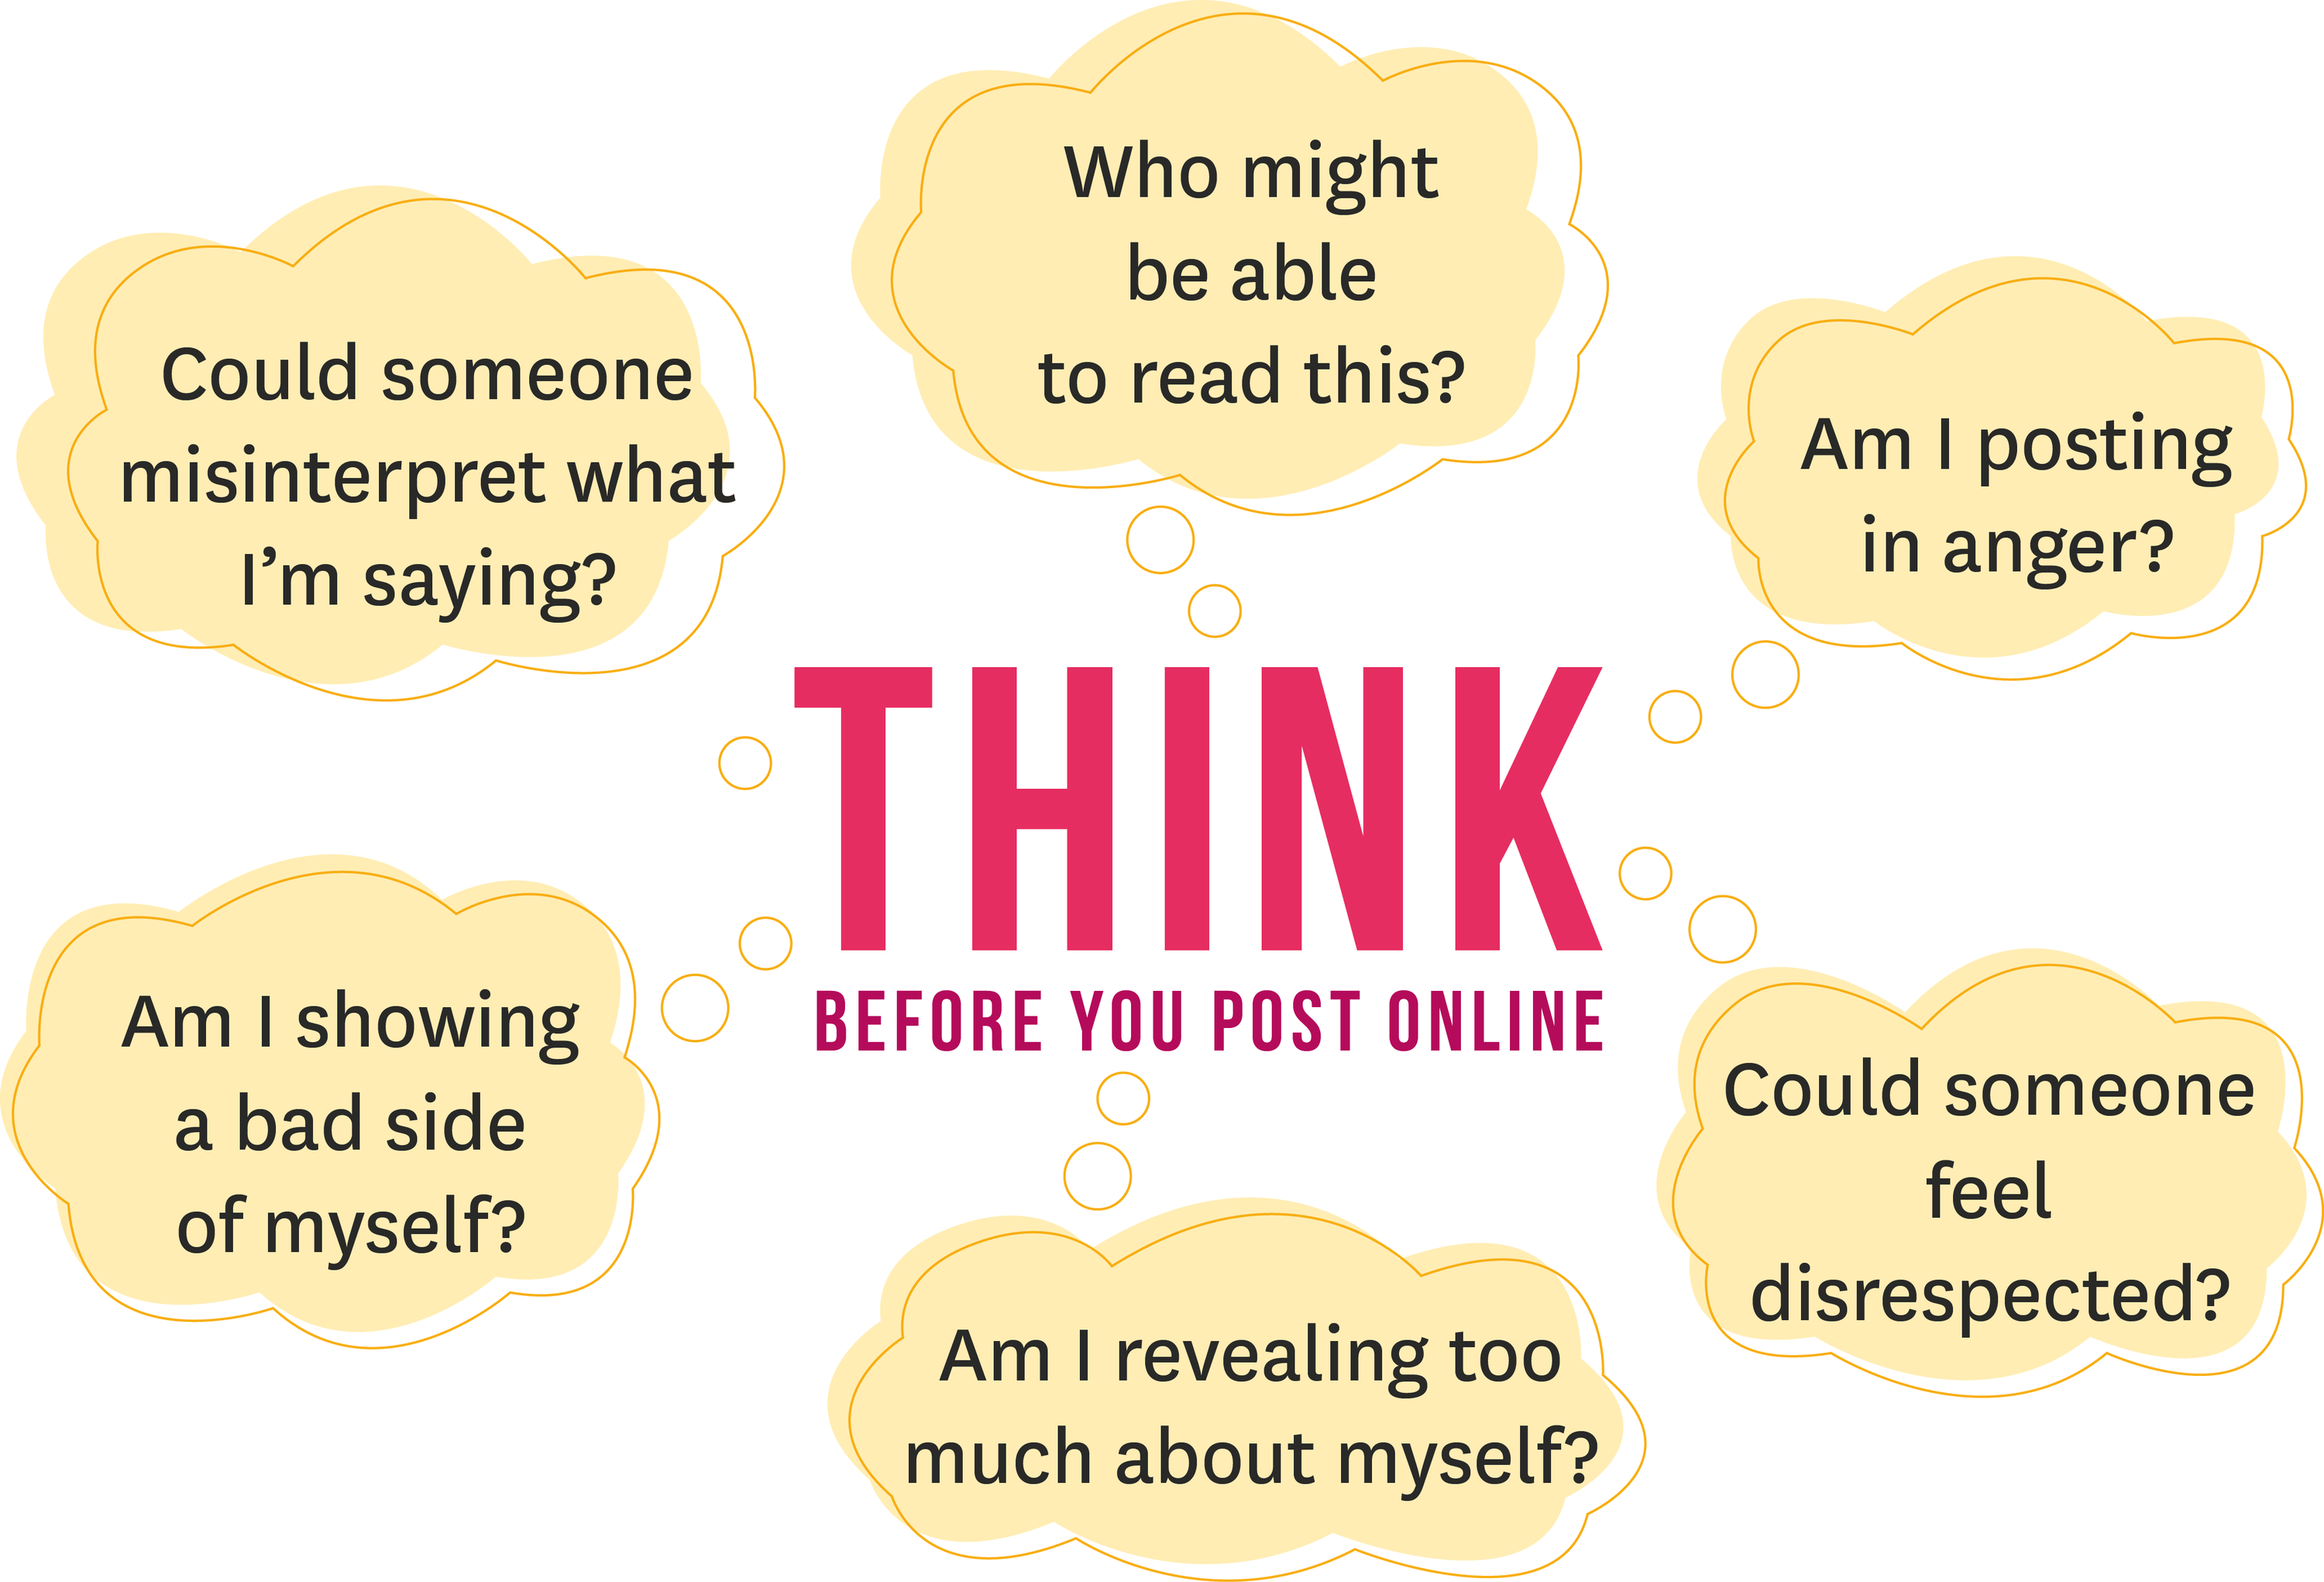
Think before you post, comment or like
Even 1 comment or 1 post of a malicious nature is considered “cyberbullying”
Notes:
Empathy… Remember to put yourself in the other person’s shoes and think

Slide 10

Promise

Slide 11
Empathy
How can We encourage people to develop Empathy???

Slide 12
Empathetic Listening in Four Steps
Step One: Set a compassionate intention in order to assure the empathetic exchange results in a caring response. Establish who will begin as speaker and who will begin as .listener.
Step Two: The speaker shares thoughts, ideas, feelings, stories, on any subject of their choice for a minute or so. The empathic listener pays close attention with the knowledge that their role is to repeat back what the speaker has shared. The empathic listener can only listen. They cannot interject, vocalize any sound, offer support, disagreement or any other response.
Step Three: The empathic listener repeats as closely as possible what the speaker said and the speaker continues for the next minute or so. Again, the empathic listener repeats as closely as possible what the speaker said. This pattern continues until the speaker says : “I feel heard”.
Step Four: Now the roles change. The speaker becomes the empathic listener and the listener becomes the speaker until once again the speaker says: “I feel heard.”
Retrieved from https://www.psychologytoday.com/ca/blog/the-bullied-brain/202211/replace-bullying-empathic-listening Dec. 12, 2022

Slide 13

What can you do instead of snapping, liking, watching and posting….
It’s Beneficial to Take a Break!!!
Read a book (paper book)
Watch a movie (not on your phone)
Exercise
Go for a walk
Phone someone and talk instead of texting
Practice some mindfulness!!
Be in the moment…
Focus on one thing at a time

Slide 14
